Slide 1
TA Training:
Grading and Assessment
Chad E. Brassil
School of Biological Sciences
Dean’s Fellow of the CAS Teaching Academy
Slides available at: www.unl.edu/cbrassil/teaching
Please interpret with questions as they arise
Notes:
include information on best practices for grading fairly and efficiently (using rubrics, blind grading, how to provide meaningful feedback on their work, etc.) as well as some information designing rubrics or assessments, especially talking making sure that assessments match the learning objectives for the class.
The TAs will have a variety of roles in the classroom (grader, lab TA, instructor of record, etc.) but all should be grading student work, whether that’s lab reports, essays, problems sets, or something else, so the goal is to cover the basics of grading to prepare them for the work they will be expected to do. About 30 per section.
Grading: think you know everything, probably know nothing
Assessment: think you know nothing, probably know everything

Slide 2
The Philosophy and Psychology of Grading

Slide 3

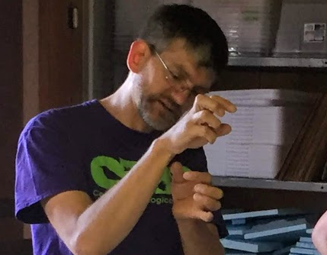

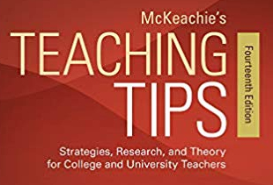
Purpose of Grading
Grad School or Employer
Do they have the skills needed?
Do they have the motivation?
Fit for our company?
Communicates Performance
Predictive
Instructor
Student
from
Master learning objectives?
Have good study skills?
Ready for next class?
Take more classes in field?
Major and career choice?
Future success in field?
Notes:
Note the emphasis on predictive
Note that professors don’t unilaterally control how this communication

Slide 4
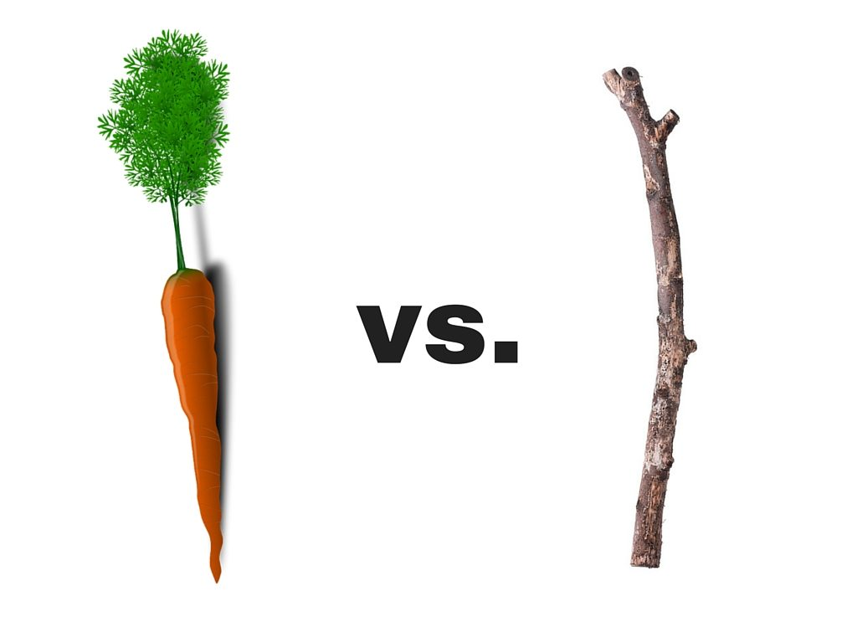

Changing Views on Grading
Grades as motivation
  Historical: threat of a low grade
  Current: motivated by success
Students as consumers

Slide 5
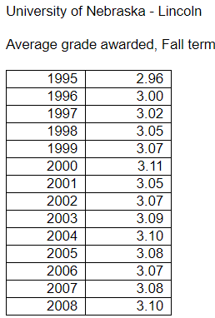
Grade Inflation
Rojstaczer and Healy. 2010. Teachers College Record.
Notes:
Vietnam Era theory on 60-70’s rise
Then viewed as plateau, but slow rise has continued
Stuart Rojstaczer & Christopher Healy — March 04, 2010
Grading in American Colleges and Universities
Teachers College Record
http://www.gradeinflation.com/

Slide 6
Norming Grades
Rojstaczer and Healy. 2012. Teachers College Record.
Notes:
Where A Is Ordinary: The Evolution of American College and University Grading, 1940–2009
Stuart Rojstaczer & Christopher Healy – 2012
Teachers College Record

Slide 7
Norming Grades
Publicly Available Grade Distributions
University of Wisconsin: https://registrar.wisc.edu/grade-reports/
University of Missouri: https://musis1.missouri.edu/gradedist/mu_grade_dist_intro.cfm
Indiana University: http://gradedistribution.registrar.indiana.edu/
Texas A&M: https://web-as.tamu.edu/gradereport/

Slide 8
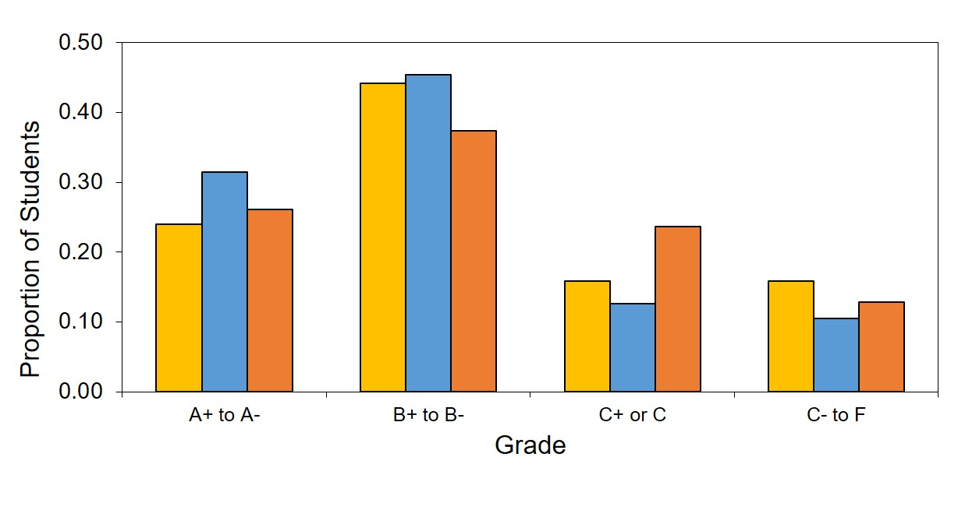
Norming Grades
LIFE 121, Instructor Chad Brassil , past 3 semester

Slide 9
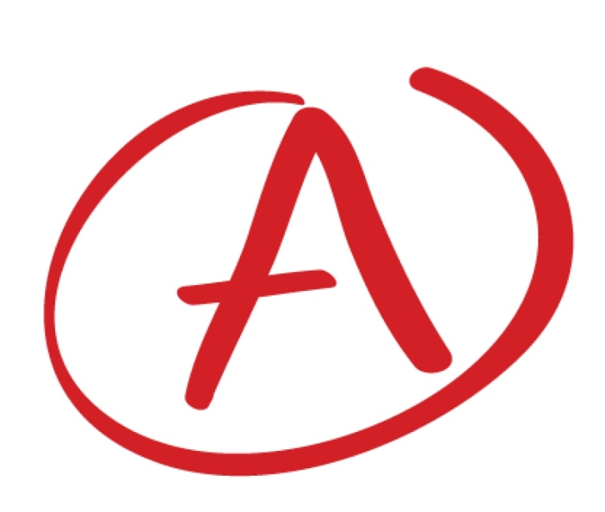
What is an A?
90% of the content
A percent of the students in a class
Colleague at another university would agree A student
All major and minor goals achieved (Travers 1950)
Rubric based on learning objectives
  (We’ll come back to this)
Travers. 1950. How to make achievement tests. Odyssey Press

Slide 10
Changing Expectations
Eiszelr. 2002. Research in Higher Education.
Notes:
Eiszler, Charles F. 2002. College Student’s Evaluations of Teaching and Grade Inflation. Research in Higher Education. 43:4.
https://www.researchgate.net/profile/Charles_Eiszler/publication/225613399_College_Students'_Evaluations_of_Teaching_and_Grade_Inflation/links/55c7792c08aeb9756746e1b3.pdf

Slide 11
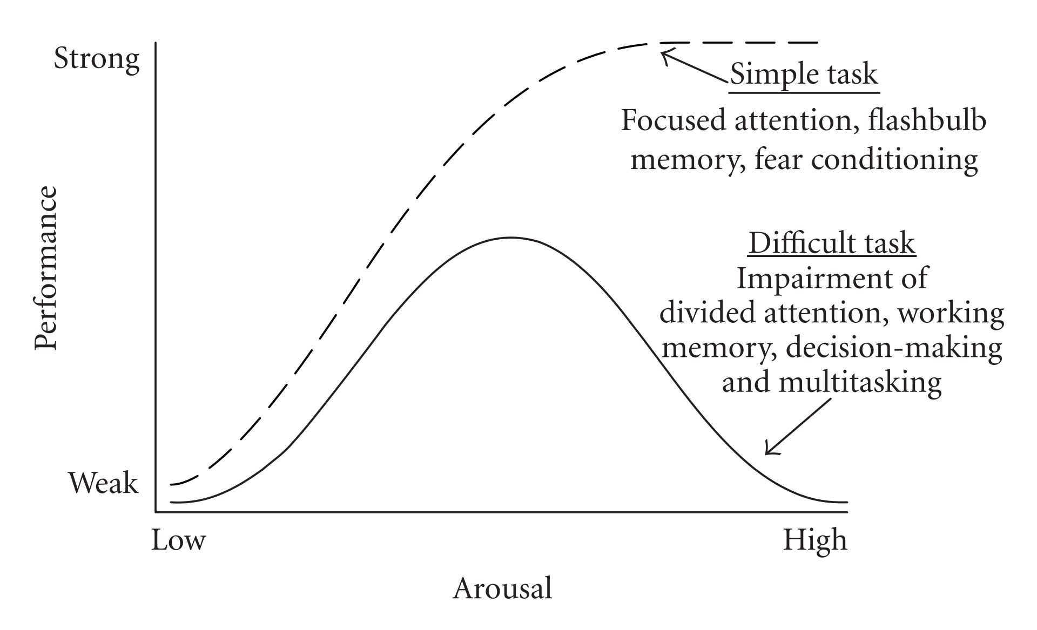
Yerkes and Dodson 1908 - Diamond DM, et al. 2007. Neural Plasticity
(i.e. Learning)
(or what some call Anxiety)
Goal:
Maximize Learning
Student Expectations
Grading Policy
Notes:
Align expectations with grading policy to maximize learning
However, keep in mind that

Slide 12

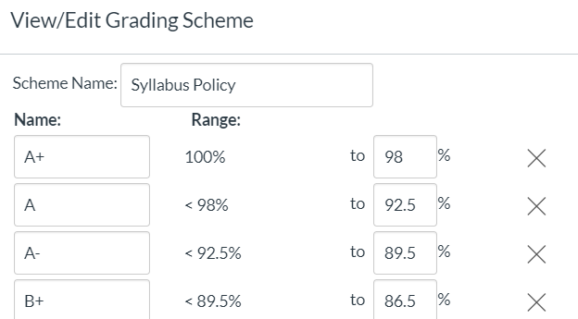
The Psychology of Grades: Hope
Canvas/Settings/Course Details
Bump final grades
  round up

Slide 13
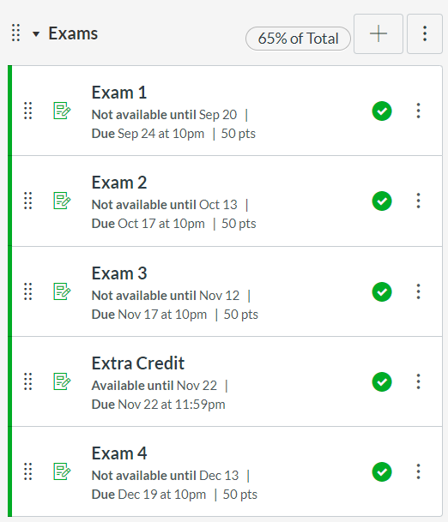
The Psychology of Grades: Hope
Bump final grades
Extra credit
  determine in advance
Worth zero points
but insert points for students

Slide 14
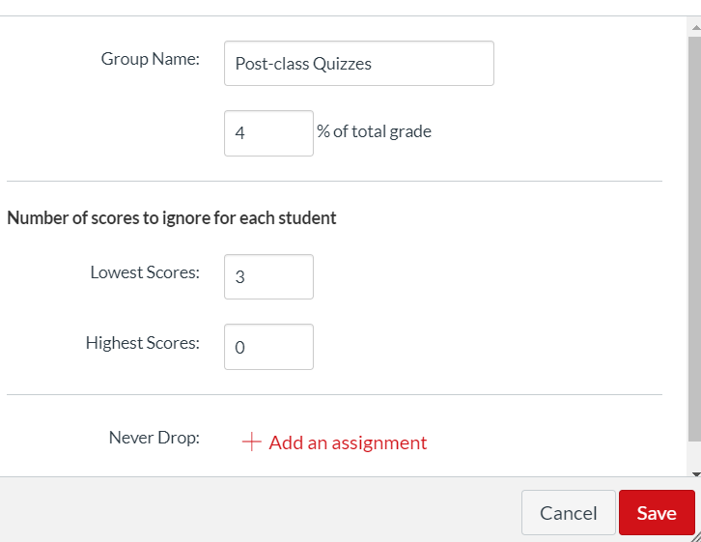
The Psychology of Grades: Hope
Bump final grades
Extra credit
Drop lowest
  implement at end

Slide 15
The Psychology of Grades: Hope
Bump final grades
Extra credit
Drop lowest
Study Contract
  Agree to best study
  practices
  Reward with
  increase in
  first exam to 70%

Slide 16
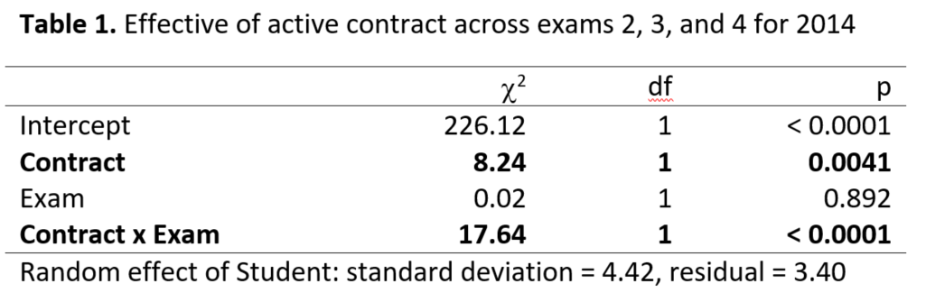
Student who complete contracts score higher on subsequent exams

Slide 17

The Psychology of Grades: Help
Use absolute grading standards,
do not grade relative to percentages for a given class
  i.e. don’t grade on a “curve”
We want students to work together to learn,
not against each other

Slide 18
The Psychology of Grades: Hubris
Bump final grades: implement at very end
Keep grades during semester more difficult
than final course grade
Be mindful of end-of-class grade appeals

Slide 19
Assessments: the alpha and the omega

Slide 20
Traditional Classroom
Textbook or Topic List
Classroom Presentation
Homework or Quizzes
Exams

Slide 21
Backward Design
Aligned
Learning Objectives
Classroom Material & Activities
Formative Assessment (Homework or Quizzes)
Summative Assessment (Exams)

Slide 22
Example LIFE121 Learning Objectives
(fine scale)
3-5 per class period
Identify conditions under which genetic drift plays a larger role, and the consequence of that drift
List the major elemental components of a plant while differentiating essential elements, macronutrients, and micronutrients
Predict the consequences of perturbations in food web modules based on an understanding of direct and indirect interactions

Slide 23
Our Learning Objectives
Articulate the purpose and audiences of grades
Appreciate the changing and current expectations around grades so that you can successfully use them to maximize learning
Use learning objectives to align the course and the assessments
Design rubrics that are aligned with the learning objectives

Slide 24
Our Learning Objectives
Articulate the purpose and audiences of grades
Appreciate the changing and current expectations around grades so that you can successfully use them to maximize learning
Use learning objectives to align the course and the assessments
Design rubrics that are aligned with the learning objectives

Slide 25
Alignment with Learning Objectives
Reconsider what you’re doing in class
  Fewer asides
  Skill focused

Slide 26
LO: Use learning objectives to align the course and the assessments
Which slide should I show next?
raise left hand
raise right hand
Example of class content,
homework, and exam
How I communicate
learning objectives to students
Notes:
Raise left hand or right hand

Slide 27
LO: Identify conditions under which drift plays a larger role, and the consequence of that drift
Lecture notes on digital whiteboard:
Chance events
  meiosis
  pairing of gametes
  accidental death unrelated to allels
  increasingly likely at small populations
Consequences
  random changes in allele frequency (non-adaptive)
  fixation of allele (can be harmful) and loss of genetic variation

Slide 28
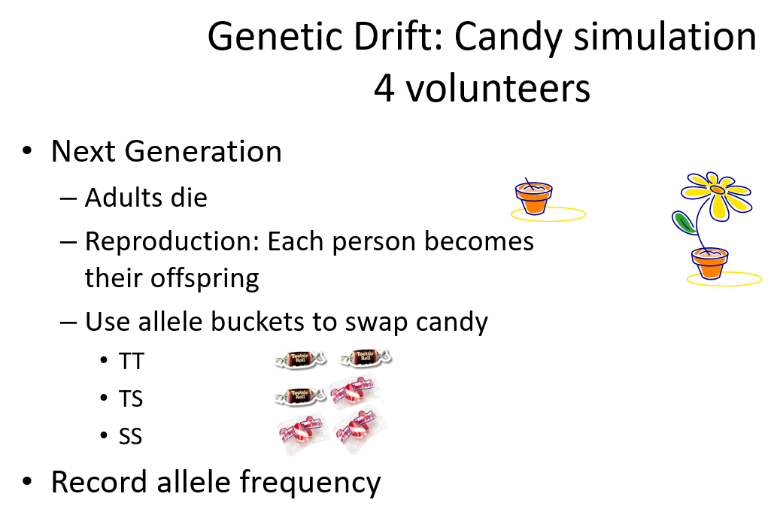
LO: Identify conditions under which drift plays a larger role, and the consequence of that drift
Class activity:

Slide 29
LO: Identify conditions under which drift plays a larger role, and the consequence of that drift
In-class “clicker” via Learning Catalytics:
What are the conditions most favorable to genetic drift?
migration of individuals
one locus, two alleles
random changes in the environment
rapidly increasing population
small population size
differential fitness

Slide 30
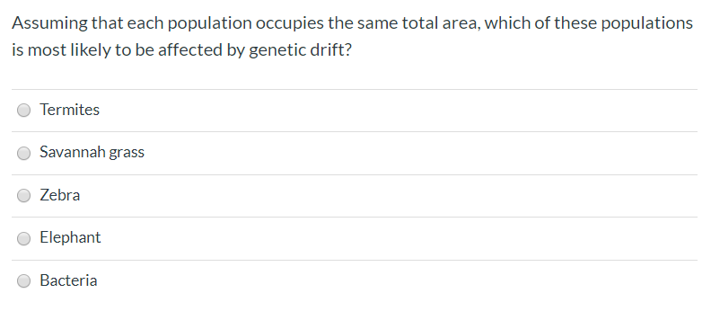
LO: Identify conditions under which drift plays a larger role, and the consequence of that drift
Post-class quiz via Canvas:

Slide 31
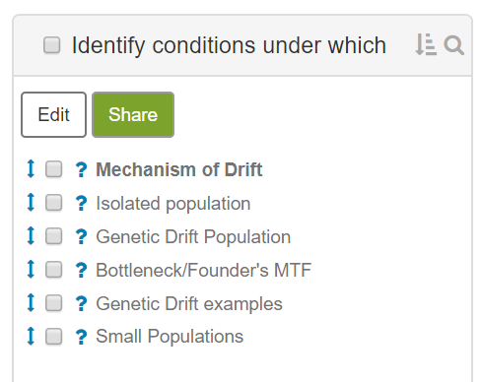
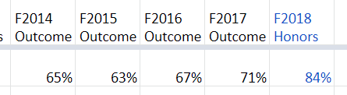
LO: Identify conditions under which drift plays a larger role, and the consequence of that drift
Exam questions in Mobius (formerly Maple TA):
Each student randomly receives two questions
Track performance over time

Slide 32
Alignment with Learning Objectives
Reconsider what I’m doing in class
Align formative with summative assessments
  Content
  Difficulty
  Skill Set

Slide 33
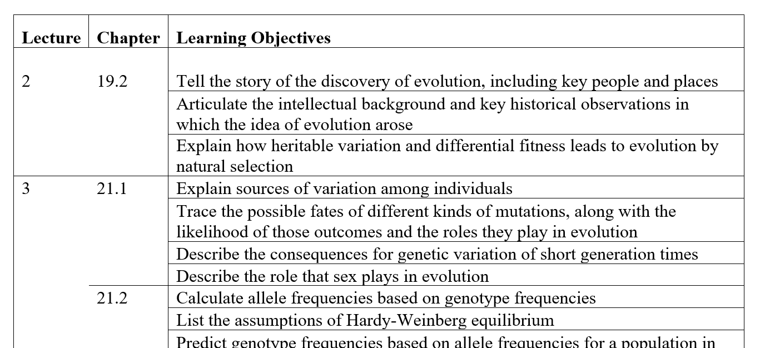
Communicate L.O. to Students
In my syllabus
(about 126 LOs)

Slide 34
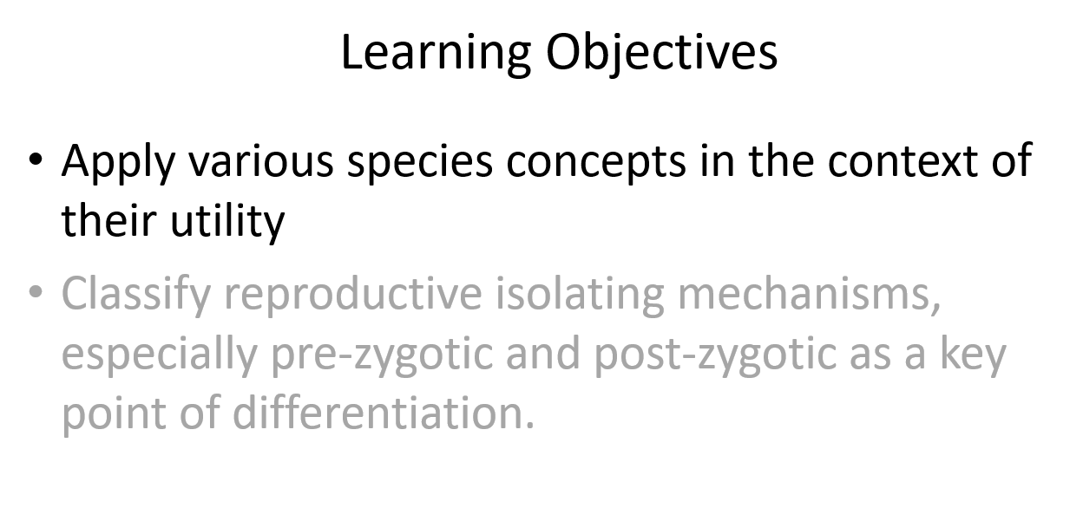
Communicate L.O. to Students
In my syllabus
In class before each subset of slides

Slide 35
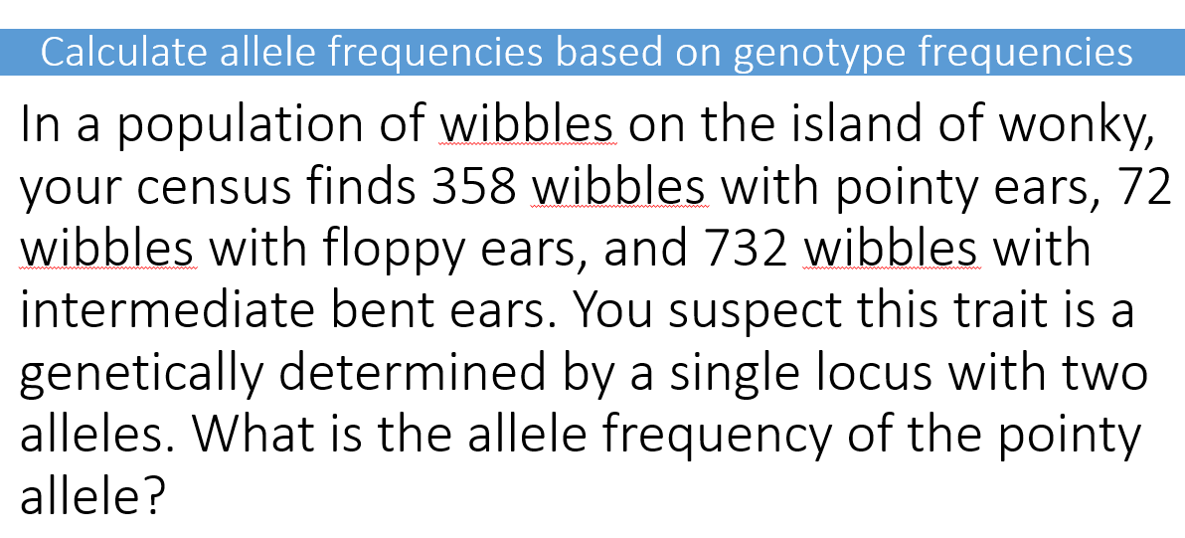
Communicate L.O. to Students
In my syllabus
In class before each subset of slides
In my exam review
Answers the question
“What is going
to be on the exam?”

Slide 36
Effective Assessments

Slide 37
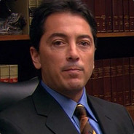
Multiple True False are Better than Multiple Choice
Which answers are correct?
T/F) Blah
T/F) Blah blah
T/F) Bob
T/F) Bob Loblaw
Which is the correct answer?
Blah
Blah Blah
Bob
Bob Loblaw
Couch, Hubbard, and Brassil. 2018. Bioscience

Slide 38
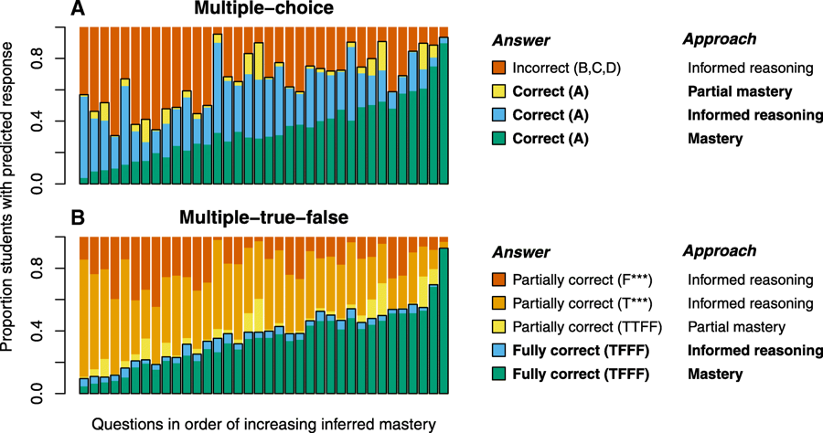
Which is the correct answer?
Brassil and Couch. 2019. International Journal of STEM Education.

Slide 39
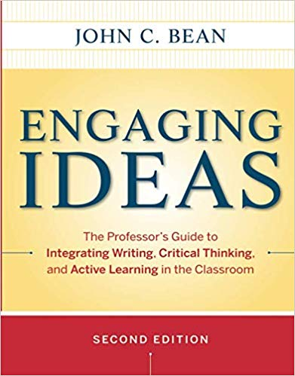
For Student Papers as Assessments
Use Rounds of Peer Assessment
Have the students provide their best work to you
Students become better writer by learning to assess others

Slide 40
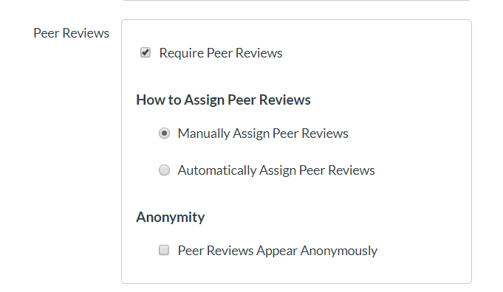
Peer Reviews In Canvas, Assignment, Edit

Slide 41
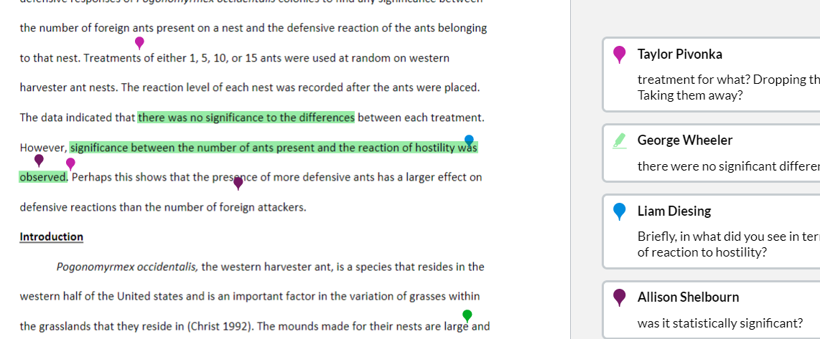
Students use “View Feedback” link to submit comments and “Show Rubric” to complete rubric
Notes:
Then see all comments combined across students

Slide 42
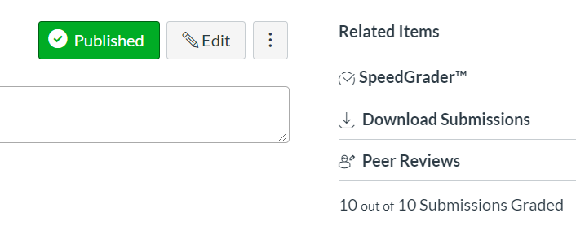
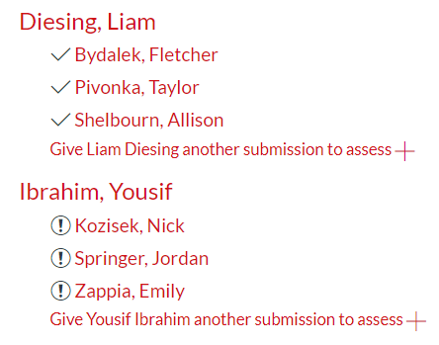
Peer Reviews In Canvas, Assignment
To grade for completing the review, manually create another assignment and manually give students points.
Notes:
Students have green check box if they submitted a comment and completed the rubric.

Slide 43
Rubrics aid assessment of papers and talks
Breaks down learning objective into rows
Articulate performance levels for each row
Communicates expectations to students
Standardizes grading practices, i.e. reliable

Slide 44
ACE 4 Use scientific methods and knowledge to pose questions, frame hypotheses, interpret data, and evaluate whether conclusions about the natural and physical world are reasonable.

Slide 45
Ideal Rubric Principles
Performance based
Separable criteria
General
  can be shared with students
  for example, ACE 4 rubric
or Specific
  has the answers
  for example, key points expected in exam essay

Slide 46
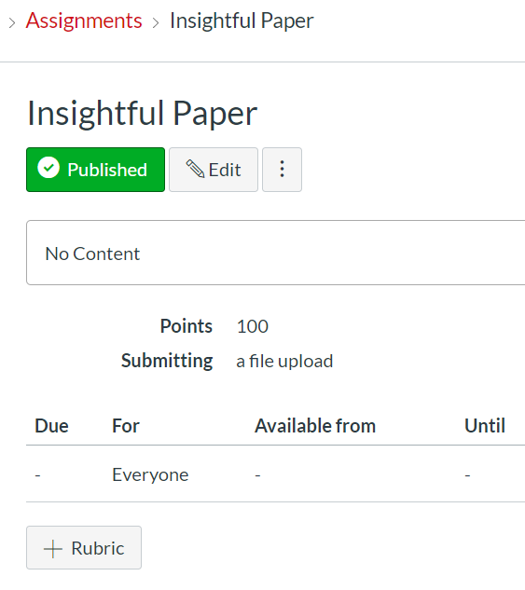
Rubrics in Canvas
First, make an Assignment
After saving…
Can also get to Rubrics by
Click on “Outcomes” in left-hand menu
Click on “Manage Rubrics” in upper right

Slide 47
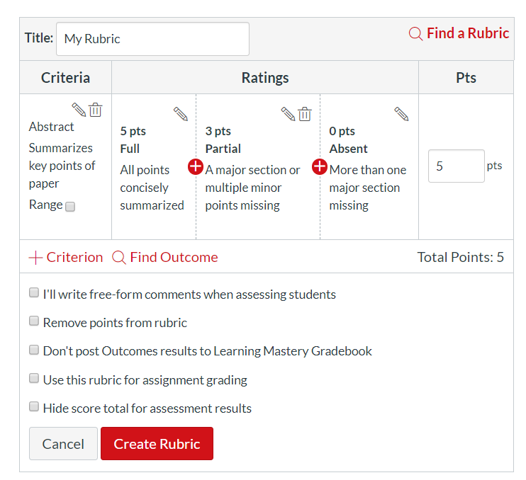
Add criterion
Add descriptions
Various options

Slide 48
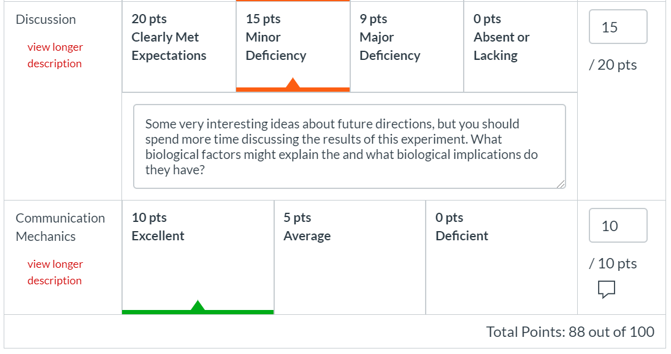
In Canvas, SpeedGrader

Slide 49
Meaningful Feedback on Work
Reduce repetitive comments on papers so you can focus on customized commentary
Use rubrics with good descriptions
Code common issues and distribute key
For example,
“CID = connect introduction to discussion”

Slide 50

Blind Grading: remove or hide names
Biases associated with knowing names
  halo effect across assignments
  implicit or unconscious bias
  Grade same question across all exams
https://thesheaf.com/2018/03/22/blind-grading-an-attempt-to-reduce-marking-bias/

Slide 51
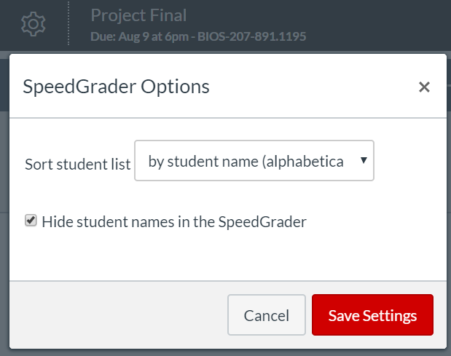
Blind Grading in Canvas
Settings in SpeedGrader
Hide student names

Slide 52
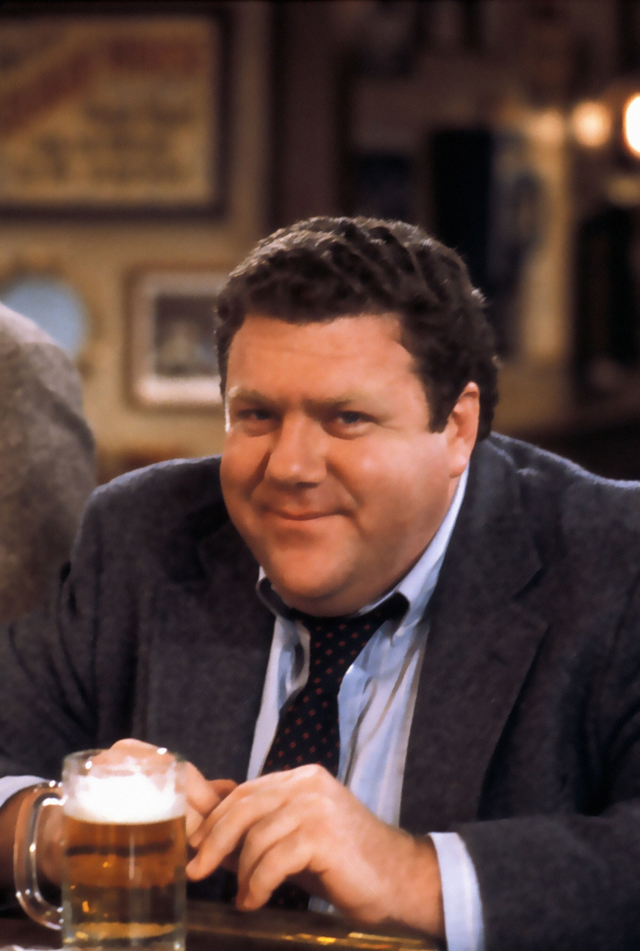
Group Norming
All TAs grade a set of papers
Discuss why you graded different
Could develop a rubric in process
Can be used to have students
grade exam essays and norm
to the instructor

Slide 53
What are some techniques for designing assessments and what are important considerations when grading it?
“When grading homework, it is important to use a green pen so that students don’t have an association between red ink and blood. It is also important to return the assignments promptly. Finally, keep in mind that students will use grades to decide if their major.
When designing homework, consider effective assessments such as Multiple True False or Rubrics. Multiple True False provide more information on student mastery for closed-ended questions, while rubrics are more effective and reliable way of assessing open-ended questions.”
Notes:
Out of 15 points

Slide 54
 | Full | Partial | Low
Assessment List | Include at least 2 items discussed in class (5 pts) | Include at least 1 item discussed in class (3 pts) | No items included from class (0 pts)
Assessment Justification | Provide a reason for assessments (3 pts) | Provide a reasons for assessments (2 pts) | Provide a reason for assessments (0 pts)
Grading | Include at least 2 items discussed in class (5 pts) | Include at least 1 item discussed in class (3 pts) | No items included from class (0 pts)
Communication Mechanics | Good paragraph organization, flow, grammar, and spelling (2 pts) | Minor errors (1 pt) | Major issues (0 pt)

Slide 55
Form Groups of 2-5
What is a past experiences you had with rubrics, and was it positive or negative?
How a rubric could be used in your upcoming class?

Slide 56
Metacognitive Moment
On notecard, write down:
What is something from this session that I can use in class this upcoming semester?

Slide 57
Grading and Assessments: Summary Topics
Grade Distributions
Grading Psychology: Hope, Help, Hubris
Study Contracts
Learning Objectives
Multiple True False
Rubrics
Blind Grading

Slide 58
Slides at: www.unl.edu/cbrassil/teaching
Chad E. Brassil
School of Biological Sciences
Dean’s Fellow of the CAS Teaching Academy

