Slide 1
The Beauty of Physics:
Patterns, principles, and perspectives
Adding a dimension
States and Transformations
Saddles
Coins, classical and quantum
Symmetry
Maps
The Problem of Time
Complexity and Emergence
A. R. P. Rau, Oxford University Press, 2014

Slide 2
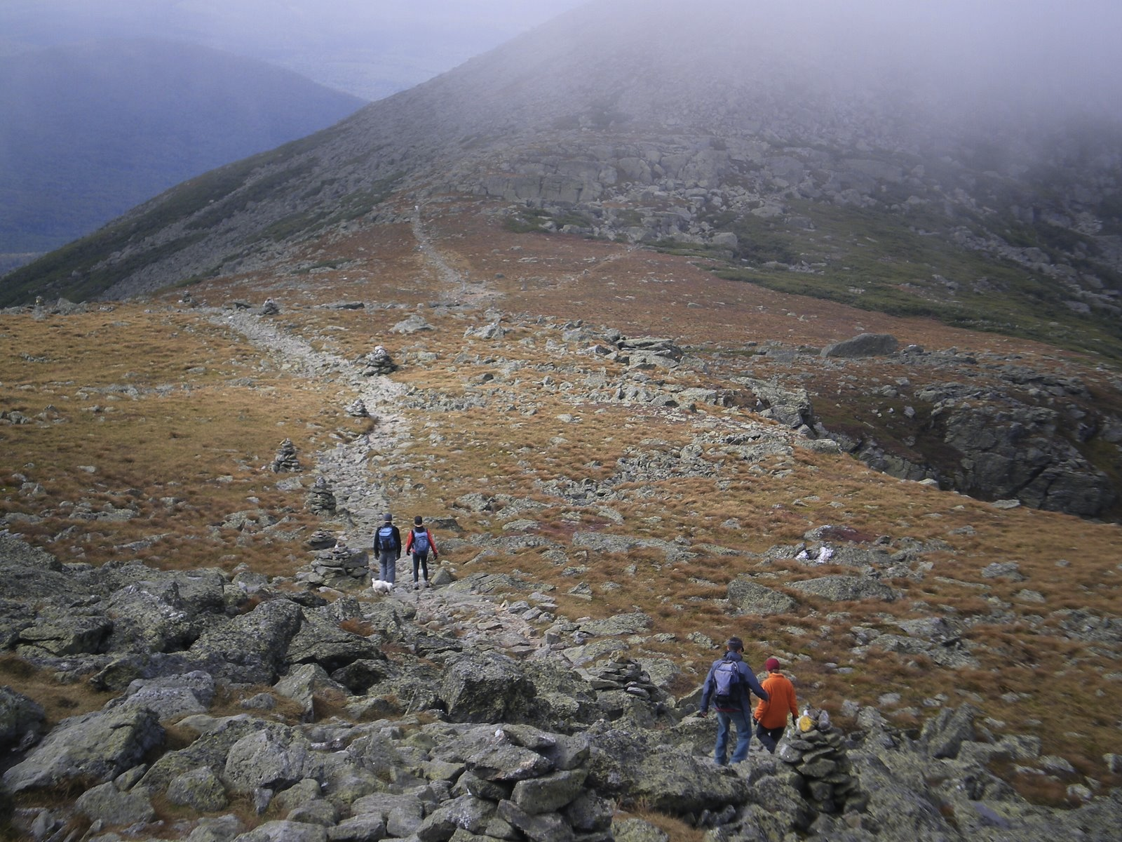

Slide 3
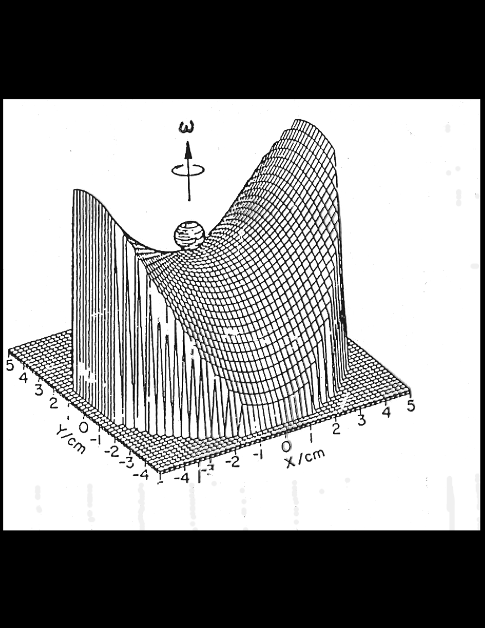

Slide 4

Trojan asteroids at
Lagrange points,
Coriolis forces,
Mechanical analog
Paul Trap for ions,
Charged particles
cannot be trapped
with only static,
electric fields.
Add rf field
Stability at saddles

Slide 5
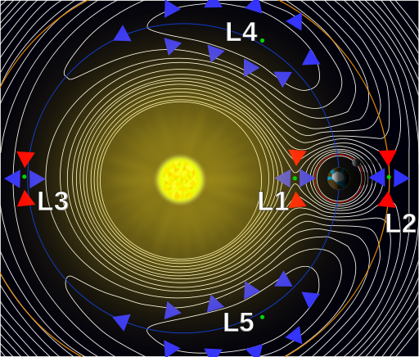
Lagrange Points
Points of quasi-stability
Sun – Jupiter
Trojan Asteroids
Artificial Satellites
Earth – Moon
Rotation
Coriolis Forces
(from kinetic energy)

Slide 6
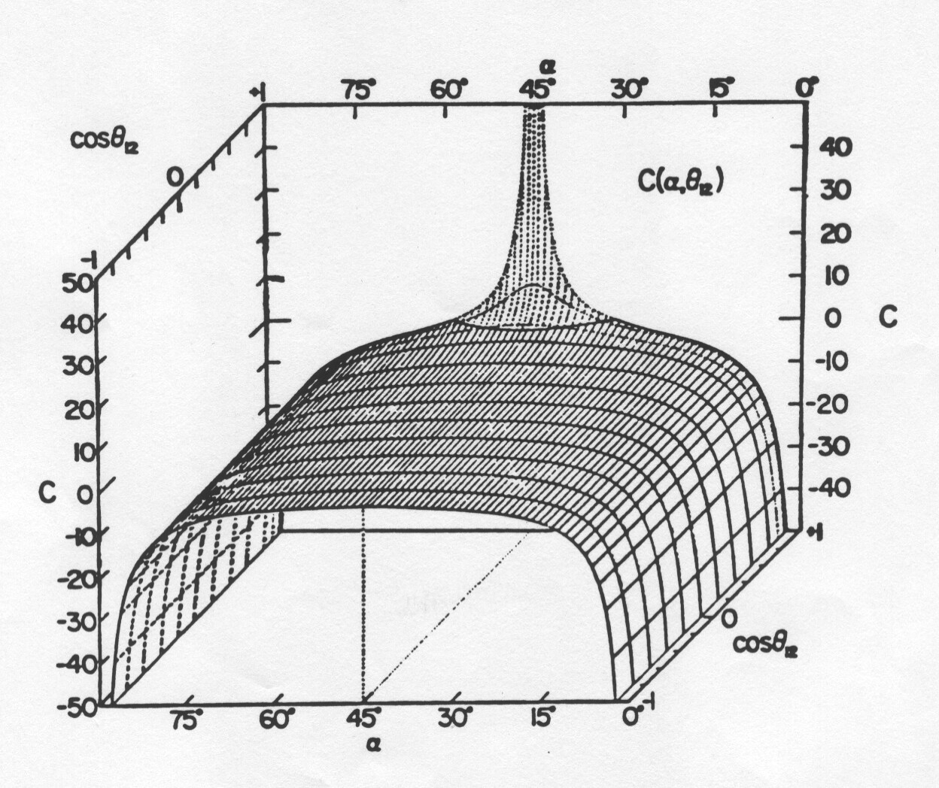
Two-electron potential energy surface

Slide 7
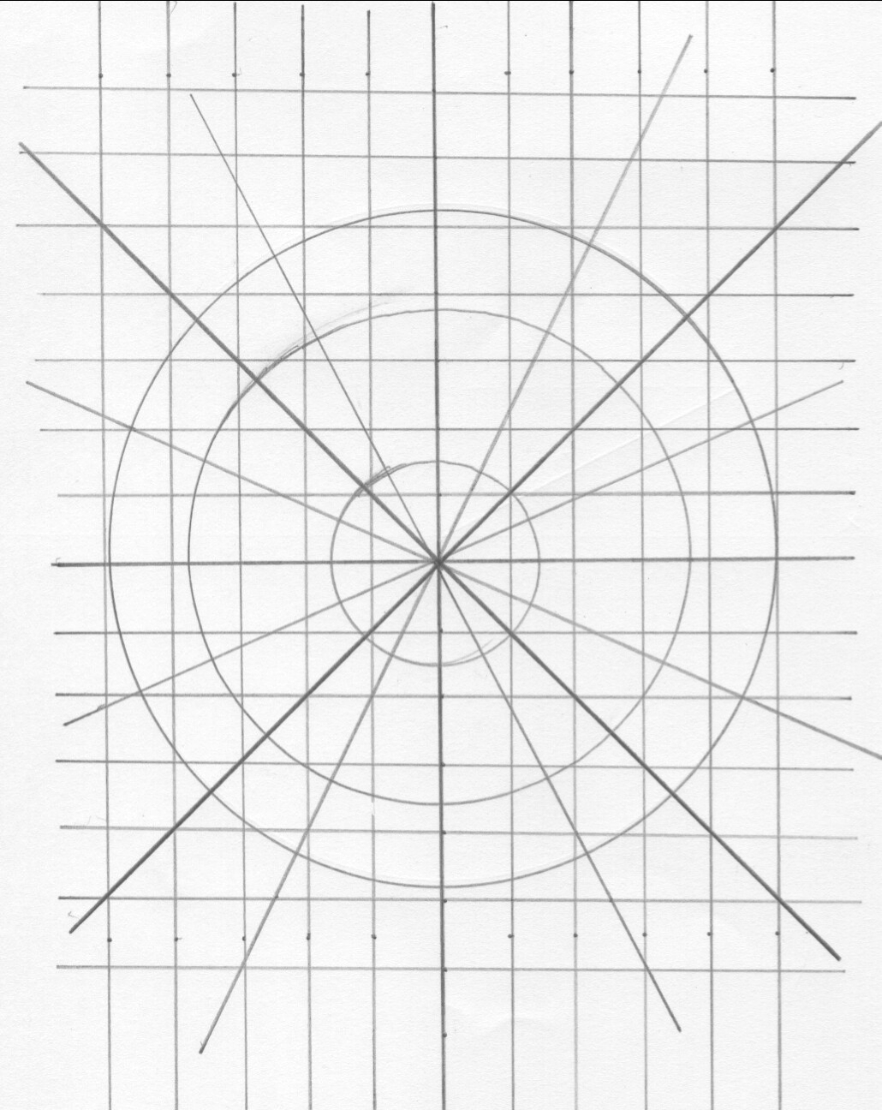
Transformation x, y → Circular
Two-electron Atom
Hyperspherical coordinates
3 Euler angles
6-dimensional coordinates

Slide 8
Two-electron atom’s potential energy
Hyperspherical coordinates
Saddle point in potential surface at
Two electrons at equal and opposite distances from Z

Slide 9
Classes of two-electron states
Valley
Saddle
Independent
particle
Hyperspherical
“pair”
Doubly-excited
and two-electron escape near threshold;
strongly correlated, angular and radial

Slide 10
Doubly-excited states of He and H⁻⁻

Slide 11
Physics of quasi-stability
Coriolis
Restoring Force
Coupling to another variable, t or R;
comes from kinetic energy “cross terms”
between R and α, crucial to Wannier theory.
More variables, more saddles, varieties, ….

