Slide 1



Slide 2
Entanglement, Squash,
and Breasthair

Slide 3

Entanglement, Squash,
and Breasthair
Chesthair
Was this a lost in translation Dutch perversion??? Or maybe not…

Slide 4
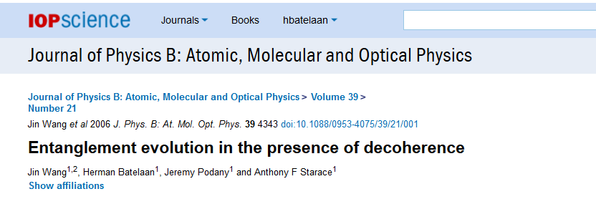
My task…explain entanglement…and why we care …
I need ….outcomes ….and … correlation

Slide 5

Tony winner of squash championships

Slide 6
Tony winner of squash championships
This is a positive outcome: assign a value M=+1

Slide 7
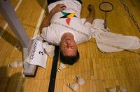
Batelaan lost
Bad outcome…assign a value of M=-1

Slide 8
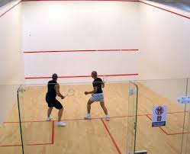
Tony Starace vs Herman Batelaan

Slide 9

Tony Starace vs Herman Batelaan
Tony obviously wins:
M_{L}=1 M_{R}=-1
Note P=M_{L}×M_{R}=-1

Slide 10
Tony Starace vs Herman Batelaan
But Tony could tear a muscle and lose:
M_{L}=-1 M_{R}=+1
Note P=M_{L}×M_{R}=-1

Slide 11
Note P=M_{L}×M_{R}=-1 always…
This expresses a perfect (anti) correlation
and is a property of such a match.

Slide 12
Note P=M_{L}×M_{R}=-1 always…
This expresses a perfect (anti) correlation
and is a property of such a match.
I need another thing to measure to explain entanglement

Slide 15

Xmas Skit
(long time ago, Tony as Tommy Lee)
(under fearless leader ship of Ken Bloom)

Slide 16
Xmas Skit
(long time ago, Tony as Tommy Lee)
(under fearless leader ship of Ken Bloom)

Slide 17
Chest hair….very manly….
This is a positive outcome: assign a value M=+1

Slide 18
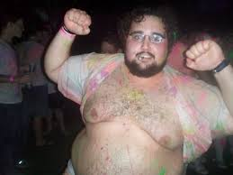
Breast hair….maybe not so manly….
This is a negative outcome: assign a value M=-1

Slide 19

Food
Exercise
No exercise
But Tony could tear a muscle and loose:
M_{HL}=+1 M_{HR}=-1
Note P=M_{HL}×M_{HR}=-1

Slide 20
The Clauser Horne Shimony Holt version of
Bell’s inequality,
making the Einstein-Podolsky-Rosen paradox testable.
-2≤P_{av}≤2
Bell's theorem tells us NOT what quantum mechanics IS, but what quantum mechanics IS NOT

Slide 21
The Clauser Horne Shimony Holt version of
Bell’s inequality,
making the Einstein-Podolsky-Rosen paradox testable.
P=M_{L}M_{R}+M_{LH}M_{RH}+M_{L}M_{RH}-M_{LH}M_{R}
-2≤P_{av}≤2
Now let’s try to break this limit by putting in as much correlation as we can.

Slide 22
P=M_{L}M_{R}+M_{LH}M_{RH}+M_{L}M_{RH}-M_{LH}M_{R}
P=(+1)(+1)+(+1)(-1)+(+1)(-1)-(+1)(+1)=-2
P=(+1)(-1)+(+1)(-1)+(+1)(-1)-(+1)(-1)=-2
P=(+1)(+1)+(-1)(-1)+(+1)(-1)-(-1)(+1)=+2

Slide 23
P=M_{L}M_{R}+M_{LH}M_{RH}+M_{L}M_{RH}-M_{LH}M_{R}
P=(+1)(+1)+(+1)(-1)+(+1)(-1)-(+1)(+1)=-2
P=(+1)(-1)+(+1)(-1)+(+1)(-1)-(+1)(-1)=-2
P=(+1)(+1)+(-1)(-1)+(+1)(-1)-(-1)(+1)=+2
P_{av}=[(-2)+(-2)+(+2)]/3=-2/3
-2≤P_{av}≤2

Slide 24
What do we get when we do the measurement for photons (or electrons or atoms, etc.)??
We get up to
P_{av}=2.8 !!!!
How?

Slide 25
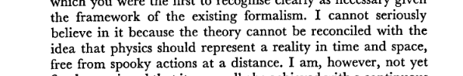
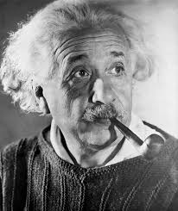
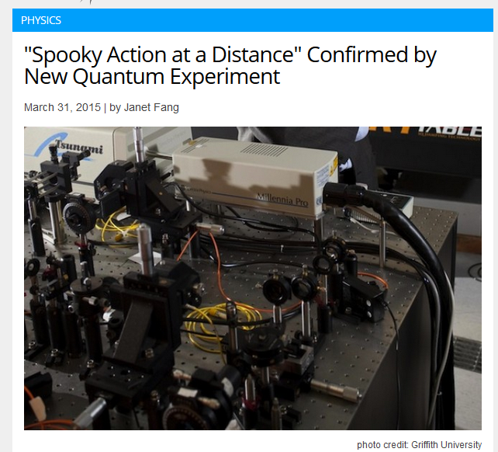
“Spooky Action at a Distance”
1947 Born-Einstein Letters

Slide 26
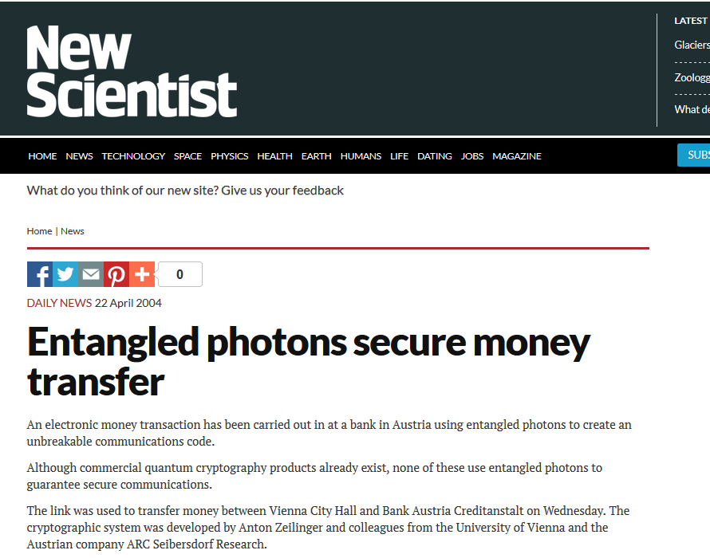
Why do we care?
In 2004:
This is “Quantum Cryptography”

Slide 27


+1
interact
-1

Slide 28
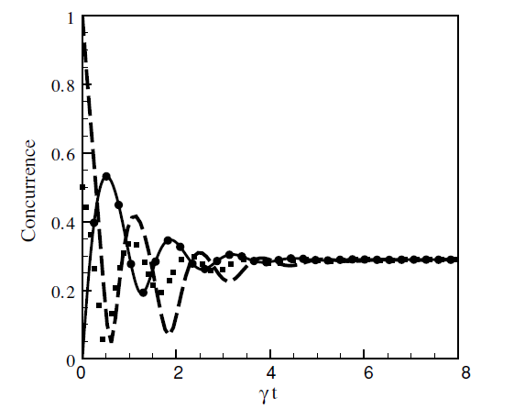

+1
interact
entanglement
-1
time

