Slide 1
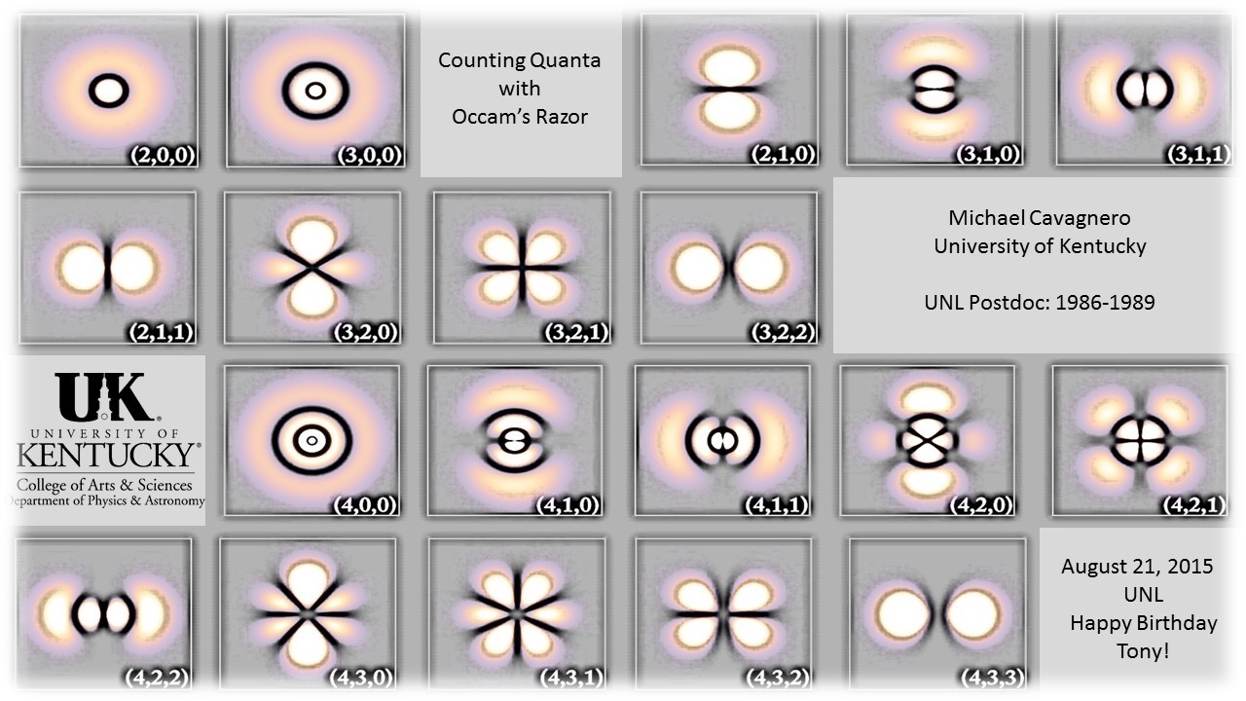
https://upload.wikimedia.org/wikipedia/commons/b/b2/Juglans_mandshurica_nutshell.jpg
Notes:
I am delighted to be here today. I’ve always admired Tony, especially for what I’ll call his characteristic rational optimism, two words you don’t often hear describing the same person these days.
Of course, we tend to admire traits we don’t share, which, I suppose, would make me an irrational pessimist. (Hey, if the shoe fits …)
Tony’s ability to find opportunities where other people only see problems has made him an excellent mentor of young researchers, as well as a very persuasive classroom teacher.
My talk today is as much about teaching and pedagogy as it is about research, though I admit that the line between the two activities has been fading for me, at least with respect to this topic. For the subject of this talk is quantum mechanics, and quantum mechanics is a strange and wonderful subject.

Slide 2
Erwin with his $Ψ$ can do Calculations quite a few. But one thing has not been seen: Just what does $Ψ$ really mean?
Erich Hückel (1988)
I think I can safely say that nobody understands quantum mechanics.
Richard Feynman (1965)
Notes:
As you listen to the various talks today, perhaps you will reflect upon the extraordinary success of quantum mechanics as a description of, and predictive tool for, a wide array of physical phenomena. The accuracy with which modern experiments in AMO physics are theoretically predicted or reproduced by quantum mechanics is nothing short of astonishing. And yet, despite great advances in coincidence detection, in quantum state control, and in the elimination of temperature as a relevant variable in many experiments, the subject remains as conceptually challenging today as it was a half-century ago.
I don’t believe that pedagogy has kept pace with other developments in the field.
What Feynman said in 1965 is probably just as true today. And that is a sobering thought.
For example, if Feynman is still right, then that means that none of today’s speakers understand what they are talking about. (If you disagree with that conclusion, then you can take it up with Feynman.)

Slide 3
https://en.wikipedia.org/wiki/Interpretations_of_quantum_mechanics
4.1 Collapse theories
4.1.1 The Copenhagen interpretation
4.1.2 Consciousness causes collapse
4.1.3 Objective collapse theories
4.2 Many worlds theories
4.2.1 Many minds
4.2.2 Branching space–time theories
4.3 Hidden variables
4.3.1 Pilot-wave theories
4.3.2 Time-symmetric theories
4.3.3 Stochastic mechanics
4.3.4 Popper's experiment
4.4 Information-based interpretations
4.4.1 Relational quantum mechanics
4.4.2 Quantum Bayesianism
4.5 Other
4.5.1 Ensemble interpretation
4.5.2 Modal interpretations
4.5.3 Consistent histories
Notes:
Of course, nature abhors a vacuum, and so our collective lack of understanding of quantum mechanics has produced a proliferation of interpretations over the last 80 years. There are so-called collapse theories, many-worlds theories, hidden variable theories (only some of which have been discarded), information-based theories, and some others that generally fall under the heading of ensemble interpretations.
One generally hears little about these theories within the AMO community, which seems far more focused on applications of quantum mechanics, and on extending the domain of applications through both technological and computational advances.

Slide 4
If you want to understand quantum mechanics, just do the math. All the words that are spun around it don’t mean very much. It’s like playing the violin. If violinists were judged on how they spoke, it wouldn’t make much sense.
Freeman Dyson (2007)
Notes:
So, many AMO scientists might subscribe to (or at least appreciate) the point of view expressed by Freeman Dyson in 2007 … a view which I shared and often discussed with students in my own classes over the past 20 years.
I guess we could call this the Nike interpretation, and add that to the list … just do it!

Slide 5
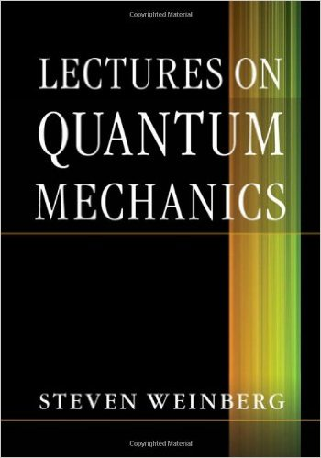
My own conclusion is
that today there is no
interpretation of quantum
mechanics that does not
have serious flaws, and
that we ought to take
seriously the possibility
of finding some more
satisfactory other theory,
to which
quantum mechanics is merely a good approximation.
Steven Weinberg in Lectures on Quantum Mechanics (2013).
Derive Born’s Rule from the time-dependent Schrodinger equation ?
$iℏ\frac{∂}{∂t}Ψ=\hat{H} Ψ → P=Ψ^{∗}Ψ$ ??
Notes:
But my view of this approach, at least from a pedagogical perspective, has changed in recent years, prodded by the publication of Steven Weinberg’s lecture notes in quantum mechanics in 2013. This excellent text reminds me of Schiff’s out of print book, which is where I first studied the subject. Weinberg includes a section of his text, Section 3.7, in which he discusses at some length the various interpretations, and in which he debunks all of them, arriving at a remarkably frank conclusion which is even stronger than Feynman’s comment 48 years earlier.
Much of his discussion centers on the so-called “measurement problem,” how one might incorporate the measurement apparatus, and possibly observers, in quantum calculations, even in principle. He describes attempts to resolve this problem by deriving the Born Rule from the time-dependent Schrodinger equation. That is to say, he, and a growing number of other authors attempt to use our ignorance of the microscopic details of the apparatus and the environment to explain the origin of quantum randomness and uncertainty.

Slide 6
Decoherence
Entanglement-Assisted Invariance
Pointer States
Quantum Darwinism
Woljciech H. Zurek
Physics Today, October 2014, Volume 67, Number 10, Page 44
Notes:
This approach to quantum mechanics is strange to me. It has culminated in a Physics Today article by Zurek which appeared in October of last year, in which the Born rule is derived “or at least motivate[d]” by consideration of the role of the environment on the measurement process.
The quantum mechanics described in this article is barely recognizable; it involves a fair number of constructs that are rarely discussed in textbooks … pointer states, decoherence, entanglement-assisted invariance (or en-variance), and even something called quantum Darwinism.

Slide 7
The Postulates of Quantum Mechanics*
At a fixed time $t_{0}$, the state of a physical system is defined by specifying a ket $|Ψ\left(t_{0}\right)>$ belonging to the state space.
Every measurable physical quantity A is described by an operator A acting in E; this operator is an observable.
The only possible result of the measurement of a physical quantity A is one of the eigenvalues of the corresponding observable.
When the physical quantity A is measured on a system in the normalized state $|Ψ>$ , the probability $P\left(a_{n}\right)$ of obtaining the non-degenerate eigenvalue $a_{n}$ of the corresponding observable A is: $P\left(a_{n}\right)= {\left|<u_{n}\right|Ψ>|}^{2}$ where $|u_{n}>$ is the normalized eigenvector of A associated with the eigenvalue $a_{n}$.
If the measurement of the physical quantity A on the system in state $|Ψ>$ gives the result $a_{n}$, the state of the system immediately after the measurement is the normalized projection $\frac{P_{n} |Ψ>}{√<Ψ\left|P_{n}\right|Ψ>}$ of $|Ψ>$ onto the eigensubspace associated with $a_{n}$.
The time evolution of the state vector $|Ψ\left(t\right)>$ is governed by the Schrὂdinger equation: $iℏ\frac{d}{dt}\left|Ψ\left(t\right)> =H\left(t\right)\right|Ψ\left(t\right)>$where $H(t)$ is the observable associated with the total energy of the system.
*Claude Cohen-Tannoudji, Bernard Diu and Franck Laloe, Quantum Mechanics, Volume I
Notes:
Zurek (of Kibble and Zurek fame, to CMPs) doesn’t just add these new constructs to the familiar paradigm, he decimates the paradigm … eliminating the spectral postulate, the collapse postulate, and the Born rule; or rather, claiming that these three postulates are instead emergent properties of a system which includes the macroscopic apparatus and environment.

Slide 8
The Postulates of Quantum Mechanics* ???
At a fixed time $t_{0}$, the state of a physical system is defined by specifying a ket $|Ψ\left(t_{0}\right)>$ belonging to the state space.
Every measurable physical quantity A is described by an operator A acting in E; this operator is an observable.
The time evolution of the state vector $|Ψ\left(t\right)>$ is governed by the Schrὂdinger equation: $iℏ\frac{d}{dt}\left|Ψ\left(t\right)> =H\left(t\right)\right|Ψ\left(t\right)>$where $H(t)$ is the observable associated with the total energy of the system.
*Zurek
Notes:
If Zurek’s analysis is correct, then quantum mechanics is not the theory we thought it was, the theory we have been teaching and using for 90 years. It is a simpler and better theory, with fewer postulates, and fewer assumptions.
But it troubles me very deeply, and I have spent a good deal of time trying to articulate why. That’s what I would like to do in the remaining time that is left to me today.

Slide 9
The pure states of an individual physical system are identified by a set of definite or indefinite experimental propositions. There exists a strict correspondence between this set of propositions and the set of subspaces of a linear vector space. [J. B. Hartle, Am. J. Phys. 36, 704 (1968).]
For a given state, definite propositions are either true or false, while indefinite propositions are decided at random.
Observed probabilities are reproducible within the limits of statistical precision, and are also independent of the location, orientation, and state of motion of the inertial reference frame in which experiments are conducted.
The generators of space and time translations, $\left\{\hat{\vec{K}}, \hat{Ω}\right\}$, are associated with the total momentum and energy of the system through the operator form of deBroglie's relation $\hat{\vec{P}}=ℏ \hat{\vec{K}}$ and it's analogue, $\hat{H}=ℏ \hat{Ω}$. The total energy and momentum of an isolated system are related by the relativistically invariant rest mass, such that ${\hat{H}}^{2}−\hat{{\vec{P}}^{2}}c^{2}=m_{0}^{2}c^{4}$.
Notes:
For many years I have regarded quantum mechanics as an empirical science based on 4 observations. I hesitate to call these “postulates” … if they are postulates, then they have greater similarity to the postulates of Special Relativity, then to the postulates of quantum mechanics.
They are observations culled from a large number of experiments, and are just as subject to the slings and arrows of outrageous fortune as are any other experimental “facts”. They are, I think, falsifiable facts. And they imply the entire structure of quantum mechanics contained within the conventional postulates of quantum mechanics.
I attribute them, in large part, to Jim Hartle, since he generated #2 in its simplest form, though he would probably attribute them to von Neumann, who revealed the nature of quantum logic, and to Dirac, who reconciled it with human logic.

Slide 10
The pure states of an individual physical system are identified by a set of definite or indefinite experimental propositions. There exists a strict correspondence between this set of propositions and the set of subspaces of a linear vector space. [J. B. Hartle, Am. J. Phys. 36, 704 (1968).]
For a given state, definite propositions are either true or false, while indefinite propositions are decided at random.
Observed probabilities are reproducible within the limits of statistical precision, and are also independent of the location, orientation, and state of motion of the inertial reference frame in which experiments are conducted.
The generators of space and time translations, $\left\{\hat{\vec{K}}, \hat{Ω}\right\}$, are associated with the total momentum and energy of the system through the operator form of deBroglie's relation $\hat{\vec{P}}=ℏ \hat{\vec{K}}$ and it's analogue, $\hat{H}=ℏ \hat{Ω}$. The total energy and momentum of an isolated system are related by the relativistically invariant rest mass, such that ${\hat{H}}^{2}−\hat{{\vec{P}}^{2}}c^{2}=m_{0}^{2}c^{4}$.
Notes:
This postulate contains several terms that require clarification.
Familiar from Newtonian mechanics, the concept of a “state” of a physical system refers simply to that information that is required to predict the outcomes of experimental observations. The word “pure” is used to stipulate that the states of interest here are those for which a maximal amount of information is available.
By an “individual physical system”, the postulate refers to a single particle, or to a single complex of interacting particles, such as a nucleus, atom, molecule, cluster, or solid, as opposed to an ensemble of such systems.
The “ set of experimental propositions also has a specific meaning. These propositions are of the Boolean True/False (or Yes/No) type, but with the essential qualification that quantum propositions can be either definite (True or False) or indefinite.

Slide 11
Notes:
An example of such a proposition is the statement “The z-component of the total angular momentum of this atom is $J_{z}=+ℏ/2$.” The truth of this proposition depends on the preparation of the atom. If the atom was prepared (or selected) with$J_{z}=+ℏ/2$, then the proposition is true; if it was prepared (or selected) with$J_{z}=−ℏ/2$, then the proposition is false. Alternatively, if the atom was initially prepared (or selected) with, say, $J_{y}=+ℏ/2$, then the proposition is indefinite. The term indefinite indicates that detection of the atom with a $\hat{z}$-Stern-Gerlach apparatus may yield a count (or event) in either of the $J_{z}=±ℏ/2$ detectors.
To more fully appreciate Hartle’s definition of the state of an individual quantum system, consider this elementary truth table of a spin-half atom. Four alternative propositions are listed in the left-hand column. In actuality, there are an infinite number of propositions, since the unit vector $\hat{n}$ ranges over the surface of a sphere. Using Hartle’s terminology, each column of the table, such as the one highlighted, represents a pure quantum state of an individual spin-half system, and that state can be uniquely labeled by the true proposition in the column. This table IS quantum information. A column of the table represents all of the information that can be known about an individual spin-half system. The column IS a state.

Slide 12
The pure states of an individual physical system are identified by a set of definite or indefinite experimental propositions. There exists a strict correspondence between this set of propositions and the set of subspaces of a linear vector space.
For a given state, definite propositions are either true or false, while indefinite propositions are decided at random.
Observed probabilities are reproducible within the limits of statistical precision, and are also independent of the location, orientation, and state of motion of the inertial reference frame in which experiments are conducted.
The generators of space and time translations, $\left\{\hat{\vec{K}}, \hat{Ω}\right\}$, are associated with the total momentum and energy of the system through the operator form of deBroglie's relation $\hat{\vec{P}}=ℏ \hat{\vec{K}}$ and it's analogue, $\hat{H}=ℏ \hat{Ω}$. The total energy and momentum of an isolated system are related by the relativistically invariant rest mass, such that ${\hat{H}}^{2}−\hat{{\vec{P}}^{2}}c^{2}=m_{0}^{2}c^{4}$.
Notes:
Quantum mechanics does not predict the outcome of an indefinite proposition
for an individual physical system. (Jim Hartle)
When one combines the vector space analysis resulting from item 1, with the randomness assertion of item 2, Born’s rule result immediately. $P=Ψ^{∗}Ψ.$

Slide 13
The pure states of an individual physical system are identified by a set of definite or indefinite experimental propositions. There exists a strict correspondence between this set of propositions and the set of subspaces of a linear vector space.
For a given state, definite propositions are either true or false, while indefinite propositions are decided at random.
Observed probabilities are reproducible within the limits of statistical precision, and are also independent of the location, orientation, and state of motion of the inertial reference frame in which experiments are conducted.
The generators of space and time translations, $\left\{\hat{\vec{K}}, \hat{Ω}\right\}$, are associated with the total momentum and energy of the system through the operator form of deBroglie's relation $\hat{\vec{P}}=ℏ \hat{\vec{K}}$ and it's analogue, $\hat{H}=ℏ \hat{Ω}$. The total energy and momentum of an isolated system are related by the relativistically invariant rest mass, such that ${\hat{H}}^{2}−\hat{{\vec{P}}^{2}}c^{2}=m_{0}^{2}c^{4}$.
Notes:
The 3rd item in the list simply notes the manifest symmetries of isolated physical systems: reproducibility in time, independence of the reference frame.

Slide 14
Notes:
The invariance of the probability under these symmetry operations in turn implies the time-dependent Schrodinger equation and the canonical commutation relations (Cavagnero, unpublished).

Slide 15
The pure states of an individual physical system are identified by a set of definite or indefinite experimental propositions. There exists a strict correspondence between this set of propositions and the set of subspaces of a linear vector space.
For a given state, definite propositions are either true or false, while indefinite propositions are decided at random.
Observed probabilities are reproducible within the limits of statistical precision, and are also independent of the location, orientation, and state of motion of the inertial reference frame in which experiments are conducted.
The generators of space and time translations, $\left\{\hat{\vec{K}}, \hat{Ω}\right\}$, are associated with the total momentum and energy of the system through the operator form of deBroglie's relation $\hat{\vec{P}}=ℏ \hat{\vec{K}}$ and it's analogue, $\hat{H}=ℏ \hat{Ω}$. The total energy and momentum of an isolated system are related by the relativistically invariant rest mass, such that ${\hat{H}}^{2}−\hat{{\vec{P}}^{2}}c^{2}=m_{0}^{2}c^{4}$.
Notes:
The only remaining task is to set the scales of mass, length and time, a feat which is accomplished by associating the generators of space and time translations with the momentum and energy, respectively.

Slide 16
The pure states of an individual physical system are identified by a set of definite or indefinite experimental propositions. There exists a strict correspondence between this set of propositions and the set of subspaces of a linear vector space. [J. B. Hartle, Am. J. Phys. 36, 704 (1968).]
For a given state, definite propositions are either true or false, while indefinite propositions are decided at random.
Observed probabilities are reproducible within the limits of statistical precision, and are also independent of the location, orientation, and state of motion of the inertial reference frame in which experiments are conducted.
The generators of space and time translations, $\left\{\hat{\vec{K}}, \hat{Ω}\right\}$, are associated with the total momentum and energy of the system through the operator form of deBroglie's relation $\hat{\vec{P}}=ℏ \hat{\vec{K}}$ and it's analogue, $\hat{H}=ℏ \hat{Ω}$. The total energy and momentum of an isolated system are related by the relativistically invariant rest mass, such that ${\hat{H}}^{2}−\hat{{\vec{P}}^{2}}c^{2}=m_{0}^{2}c^{4}$.
Notes:
So, for years I have used these 4 falsifiable empirical “postulates” to “derive” the conventional postulates of quantum mechanics.
(Note that, in the limit that $ℏ→0$, all scales vanish. In addition, items 1 and 2 become meaningless, as there is no way to distinguish spin up and spin down particles.)
Have I been doing my students an injustice all these years?

Slide 17
Occam's razor (a.k.a. the 'law of parsimony')
is a problem-solving principle devised by
William of Ockham (c. 1287–1347).
The principle states that among competing hypotheses
that predict equally well, the one with the fewest assumptions should be selected. Other, more complicated solutions may ultimately prove to provide better predictions, but—in the absence of differences in predictive ability—the fewer assumptions that are made, the better.
Notes:
How does one distinguish the various interpretations of quantum mechanics, if not empirically?

Slide 18
In this formulation, the time-dependent Schrodinger equation results from the invariance of probability distributions under time-translations, and is a secondary aspect of quantum mechanics.
The key to quantum mechanics lies, instead, in the definition of the state of an individual system, and in the correspondence between states and experimental propositions.
How can I reconcile my pedagogical approach to quantum mechanics with Quantum Darwinism and with the derivation of the Born Rule from the TDSE?
Notes:
Here are my lackluster conclusions.

Slide 19
https://upload.wikimedia.org/wikipedia/commons/b/b2/Juglans_mandshurica_nutshell.jpg
Notes:
One characteristic which Tony shares with my thesis advisor, Ugo Fano, is the emphasis they place on careful articulation of difficult issues.
I have done my best to follow their lead in this regard, and hope that my students are better for it.
Thanks, Tony

