Slide 1
Transition Planning for Individualswith ASD: Part 3 of 4: The Central Importance of Sexual Education in ASD
Peter F. Gerhardt, Ed.D.
Executive Director, The EPIC School

Slide 2
Acknowledgements
I would like recognize following individuals for their contributions in the development of this presentation:
Megan Atthowe, R.N., M.S., BCBA
Frank Cicero, Ph.D., BCBA
Joanne Gerenser, Ph.D.
Isabelle Henault, Ph.D.
Lisa Mitchell, LCSW
Bobby Newman, Ph.D. BCBA
Sorah Stein, M.S., BCBA
Zosia Zaks, M.A., BCBA, and
Many, many students, adults, and families.

Slide 3
The following presentation contains language and imagery of a sexual nature and may be considered inappropriate for younger listeners and viewers.
TV
MA

Slide 5
As a general rule of thumb about 60% of sexuality education should be at home, about 37% can be done in the context of the school and, when necessary, about 3% by specialists. But I sort of just made that up

Slide 6
Prudish Promiscuity?
Sex and sexuality, as serious topics for discussion, are ones that many of us would rather avoid than address. In fact, according to the CDC fewer than half of all high schools and only 20% of middle schools offer a comprehensive Sex Ed curriculum. Further, only 23 states mandate Sex Ed at all and, of those, only 13 require it to be medically accurate. (Orenstein, 2016)
Orenstein, P. (March 20, 2016). When did porn become sex ed? New York Times Sunday Review. pp1, 6.

Slide 7
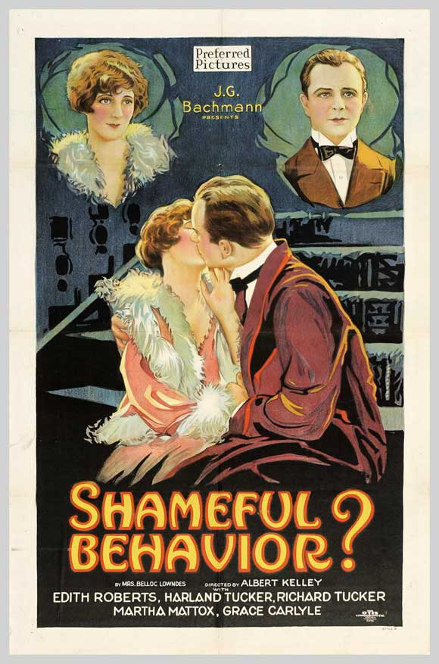
Now add to that the personal and societal constraints that move sexual behavior out of the realm of simple behavior and we have a cohort of skills in which there is high interest but limited knowledge.

Slide 8
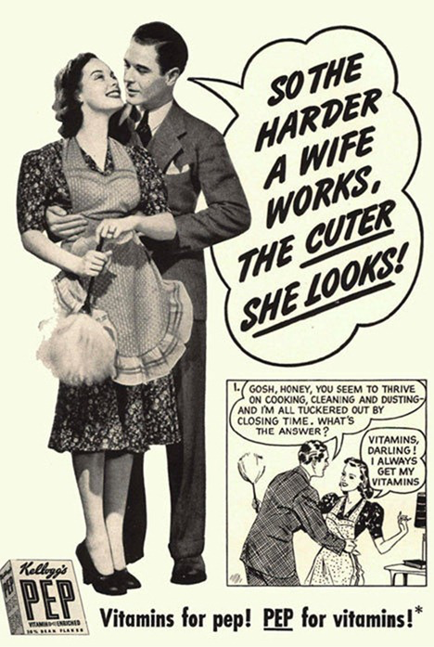
But let’s not forget there is, historically, more than a touch of misogyny in all this…

Slide 9
And when it came to individuals with DD
Richards, et al (2006) noted that, historically, individuals with DD been viewed as sexually deviant, prone to criminality, asexual, and problematic to society. Despite significant progress over the last 5 decades in many areas, the sexuality of individuals with DD is still grossly misunderstood by society. And although today the sexuality of individuals with DD is not entirely ignored, nor is sexual behavior universally punished, the perception that people with developmental disabilities as perpetual children, irrespective of their age, still lingers with significant, negative consequences.
Richards, D., Miodrag, N., & Watson, S. L. (2006). Sexuality and developmental disability: Obstacles to healthy sexuality throughout the lifespan. Developmental Disabilities Bulletin, 34(1-2), 137-155.

Slide 10
We are Sexual Beings
Typical children are taught many things about their own sexuality from the day they were born. For example, they learn:
How they are touched by others;
The way their bodies feel to them;
What their family believes is okay and not okay to do;
The words that family members use (and don’t use) to refer to parts of the body; and
From watching the relationships around them.
In addition, as they grow they acquire a great deal from outside sources including television, music, friends and their interactions with the world around them.

Slide 11
And, yes, we can just ignore this nonsense

Slide 12
Typical Sexual Development
Preschool children (less than 4 years) | Exploring and touching private parts, in public and in private Rubbing private parts (with hand or against objects) Showing private parts to others Trying to touch mother’s or other women’s breasts Removing clothes and wanting to be naked Attempting to see other people when they are naked, undressing, or in bathroom Talking to other children about bodily functions such as “poop” and “pee”
Young Children (approximately 4-6 years) | Purposefully touching private parts (masturbation)in public and private Attempting to see other people when they are naked or undressing Mimicking dating behavior (such as kissing, or holding hands) Talking about private parts and using “naughty” words, in absence of meaning Exploring private parts with children their own age (such as “playing doctor”, “I’ll show you mine if you show me yours,” etc.)
School-Aged Children (approximately 7-12 years) | Purposefully touching private parts in private Playing games with children that involve sexual behavior ( “playing family”) Attempting to see other people naked or undressing Looking at pictures of naked or partially naked people Viewing/listening to sexual content in media Wanting more privacy, e.g., not wanting to undress in front of other people; reluctant to talk to adults about sexual issues Beginnings of sexual attraction to/interest in peers
Source: National Child Traumatic Stress Network (2009). Sexual development and behavior in children. Downloaded from: http://nctsn.org/nctsn_assets/pdfs/caring/sexualdevelopmentandbehavior.pdf

Slide 13
And What Information Typical Children Need
Preschool Children (less than 4 years)
The difference between “okay” touch and “not okay” touches
Your body belongs to you
Everyone has the right to say “no” to being touched, even by grownups
No one has the right to touch your genitals
You can say “no” when grownups ask you to do things such as touching genitals
Who to tell if people do “not okay” things to you, or ask you to do “not okay” things to them

Slide 14
And What Information Typical Children Need
Young Children Safety Information (4-6 years)
Sexual abuse = someone touches your body/genitals or asks you to touch theirs
It is sexual abuse even if it is by someone you know
Sexual abuse is NEVER the child’s fault
If a stranger tries to get you to go with him or her, run and tell a parent, teacher, neighbor, police officer, or other trusted adult
School-Aged Children (7-12 years)
Sexual abuse may or may not involve touch
How to maintain safety and personal boundaries
Technology risks including chatting or meeting people online
How to recognize and avoid risky social situations
Dating rules

Slide 15
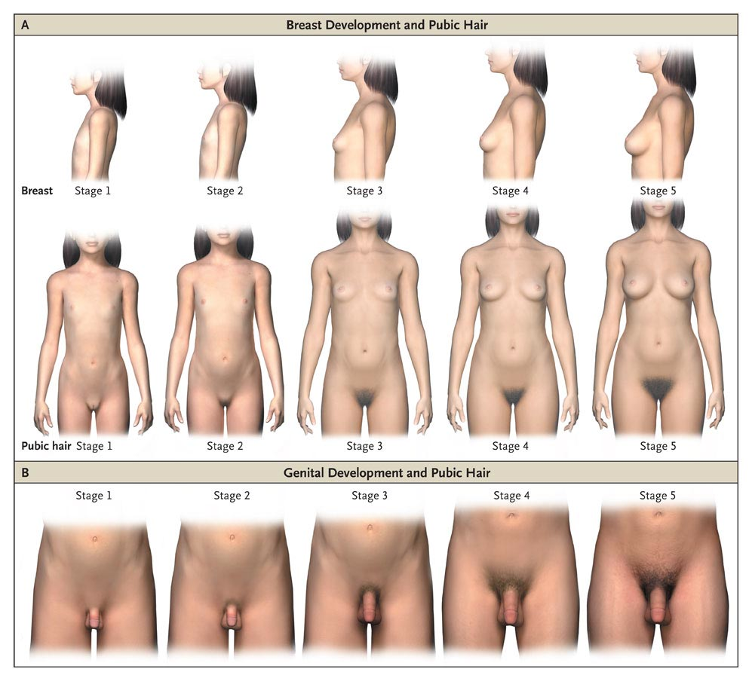
Then There’s Puberty

Slide 16
Onset of Puberty
Over the past 2-3 decades the age of puberty onset has decreased. For girls, breast development, typical of 11-year-olds a generation ago, is now occurring in more seven-year-olds. Research indicates that childhood obesity may be the primary causative factor. However, family stress and chemical exposures in the environment may also play a role, but the data are unclear as to degree of contribution. For boys, the data are murkier, but one study did suggest that they, too, may be starting puberty earlier than before—perhaps by as much as six months to two years. (Maron, 2015)

Slide 17
Puberty and ASD
There is a tendency for parents and professionals to ignore or misinterpret:
The emotional impact of puberty/adolescence on individuals with ASD.
The function of reflex, or spontaneous, erections at the onset of puberty in males.
That genital stimulation is a universal phenomena that often begins in the womb.
The importance of anticipating puberty, adolescence, and sexual behavior and planning for such. Hence, my adherence to the 5-year rule

Slide 18
ASD, Puberty, and Behavior
There is an ongoing discussion regarding the relationship between puberty and the display of challenging behavior. What we lack, however, are actual data. What seems to be true, however, is:
For some individuals the onset of puberty may be associated with an increase in challenging behavior.
This increase, however, may then be reinforced as a result of their newly realized increase in size and strength (i.e., the behavior is now more effective).
We do tend to see behavior challenges associated with menstrual cycles and some research indicates that females with ASD present with more challenges than their peers with other disabilities.
A new class of behavior, sexual stimulation, may develop. But absent a functional assessment of sexual stimulation, it is generally assumed to be maintained by automatic reinforcement which is not always the case.

Slide 19
But enough about that…

Slide 20
So really, how much research is there on impact of sexuality education and related interventions in ASD?

Slide 22
A few things we probably do know (Kellaher, D., 2015)
At least some of our gap in understand sexuality and sexual behavior in ASD stems from an general lack of understanding about sexuality and sexual behavior.
High verbal individuals appear similar to typical peers in terms of sexual interest.
While high verbal adults may know the language of sexuality, this does not seem to equate to qualitative or quantitative knowledge or behavior.
There appears to be a greater diversity of sexual expression with high verbal individuals with higher reported rates of asexuality, bisexuality, and homosexuality, particularly among women.

Slide 23
A few things we probably do know (Kellaher, D., 2015)
Although data are limited there are published reports of paraphilic behavior among HV males but none involving HV females. The gender difference is due, most likely, to multiple confounding variables but it does appear that every permutation of sexual behavior we see in the typical community exists in the HV/ASD community.
In ASD, however, some paraphilic behavior represent “counterfeit deviance” (Hingsburger, Griffiths, & Quinsey, 1991) in that it originates from an absence of knowledge, experience, or specific social competencies.
Kellaher, D.C. (2015). Sexual behavior and ASD: An update and discussion. Current Psychiatry Reports, 17, Published online March 2015
Hingsburger, D., Griffiths, D., & Quinsey, V. (1991). Detecting counterfeit deviance: differentiating sexual deviance from sexual inappropriatness. Habilitative Mental Healthcare Newsletter, 51-54.

Slide 24
Most Recently
McDaniels & Fleming (2016), in their review of 92 articles published on sexual education with individuals with ID concluded that:
As a result inadequate sexual education Individuals with ID are placed at a greater risk for sexual abuse, STDs, and misinformation than warranted.
Formal, individualized, and specific sexual education for learners with ID is lacking.
There is a paucity of published data resulting in little information as to appropriate and empirically validated sexual education content and processes for learners with ID
McDaniels, B, & Fleming, A., (2016). Sexuality Education and Intellectual Disability: Time to Address the Challenge. Sexuality and Disability, 34, 215-225.

Slide 25
A Couple of Good Reasons Why We Should Teach Human Sexuality Education To Individuals With Autism Spectrum Disorders
Notes:
A Couple of Good Reasons Why We Should Teach Human Sexuality Education To Individuals With Autism Spectrum Disorders

Slide 26
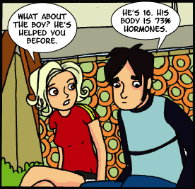
Number 6
They Have The Same Hormones &Urges & Need To Make The Same Choices As Their Peers

Slide 27
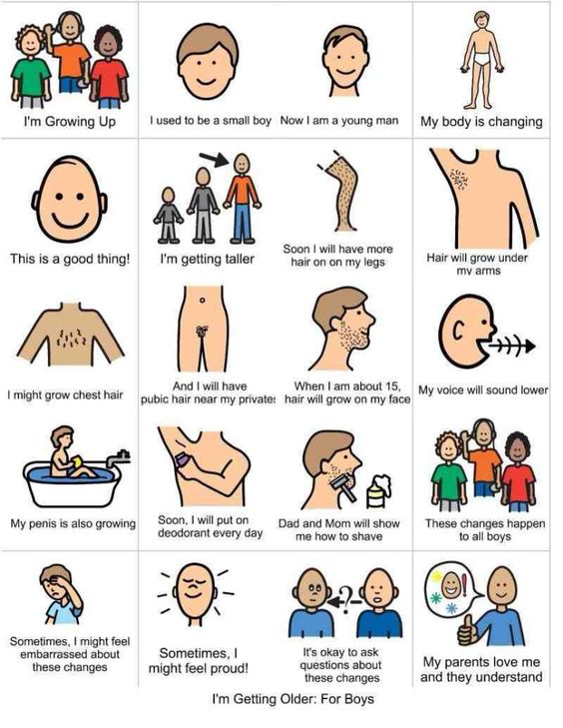
Number 5
All sexual behavior is social behavior and, as such, is particularly challenging for individuals with ASD

Slide 28
Number 4
The Internet and other readily accessible media

Slide 29
Mitchell, K. J.; Finkelhor, D,; and Wolak, J. (2003). The exposure of youth to unwanted sexual material on the internet: A national survey of risk, impact, and prevention. Youth Society, 34, 330-358.
Just how accessible is pornography?
In a national survey of youth ages 10-17 years, Mitchell, et al (2003) reported that 25% of youth had unwanted exposure to sexual pictures on the Internet in the past year. The use of filtering and blocking software was associated with a modest reduction in unwanted exposure, suggesting that it may help but is far from fool proof. The authors urge that social scientific research be undertaken to inform this highly contentious public policy controversy.

Slide 30
For example, a search for “woman in kitchen” in Bing images with the safe filter off finds:

Slide 31
For typical kids…
According to Crabbe and Corlette (2010), porn has become a central mediator of young people’s sexual understanding and experience and a “go to” source for information of sex and sexuality in the absence of any formal sex education.
Crabbe, M. & Corlette, D. (2010) Eroticizing inequality: Technology, pornography, and young people. DVRCV Quarterly. 3, 1-6. Accessed on line on 3/36/16 at:http://www.awe.asn.au/drupal/sites/default/files/Crabbe%20Corlett%20Eroticising%20Inequality.pdf

Slide 32
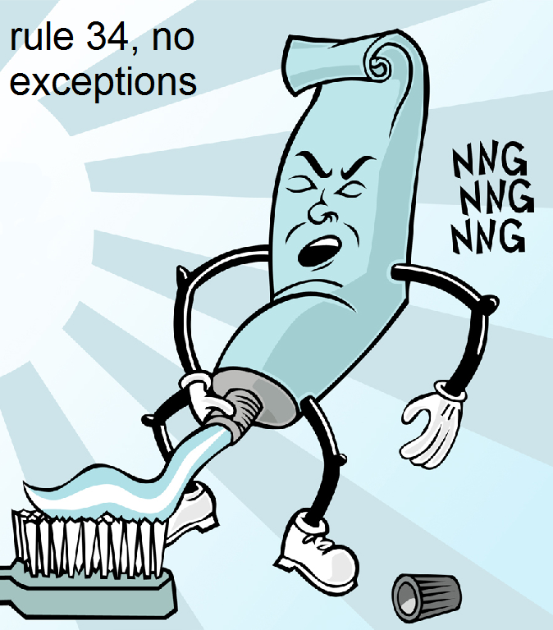
And then there is Rule 34: “If it exists, it exists as internet porn. No Exceptions.”

Slide 33
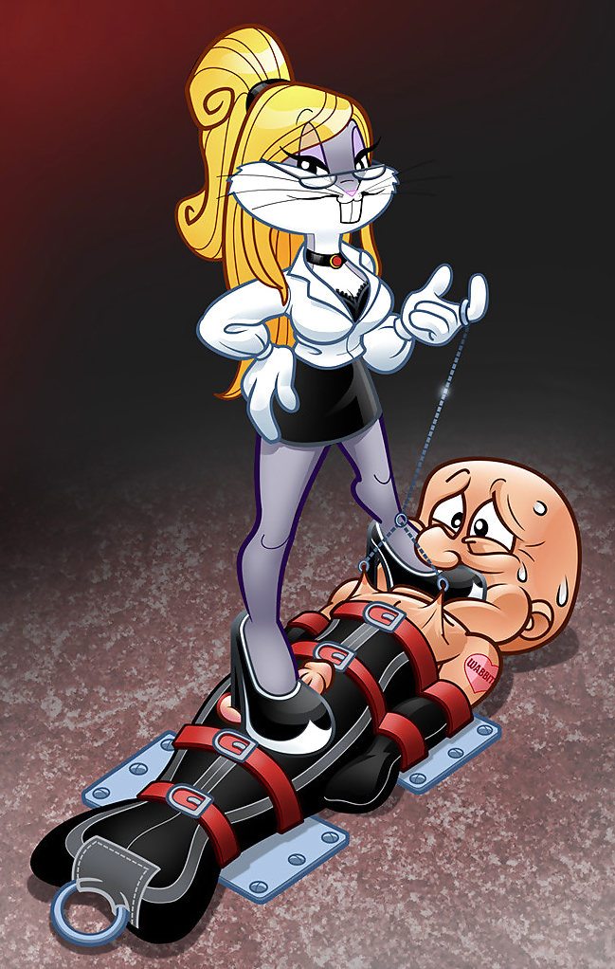

Slide 34
But most problematic, at least in my opinion, is Hentai which is pornographic Anime that is often very misogynistic and violent

Slide 36
From a new eboo friend
"Hey, I added you since you look familiar, but once I looked at your page I knew I was mistaken.. but hey, you seem like a good guy so i'll just introduce myself :) Im quirky, funny, and never afraid to have a good time.. I recently moved here about six months ago from a small town in Idaho for work and like it so far! Check out my profile.. if you want to I would love to meet sometime for lunch. Any way.. I wanted to attach more photos of me but its giving me some stupid error! If you give me your email addy I can send the pics to you that way. Hope to hear from you soon!"

Slide 37
A recent (2/2016) friend

Slide 38
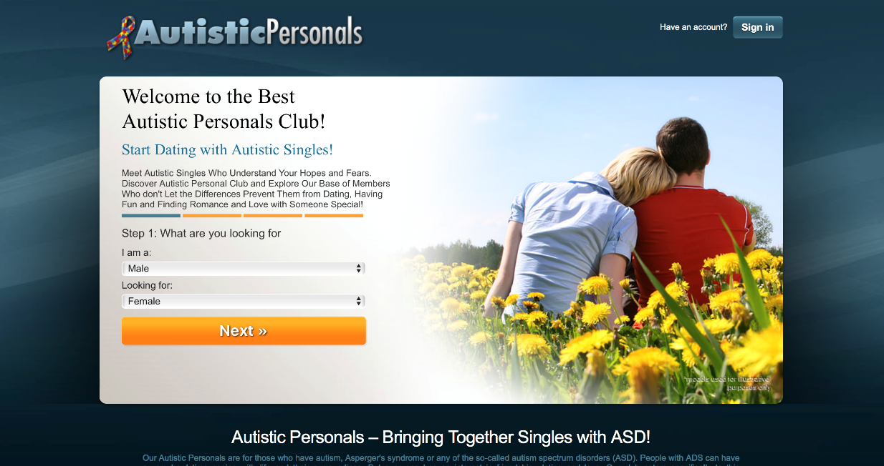
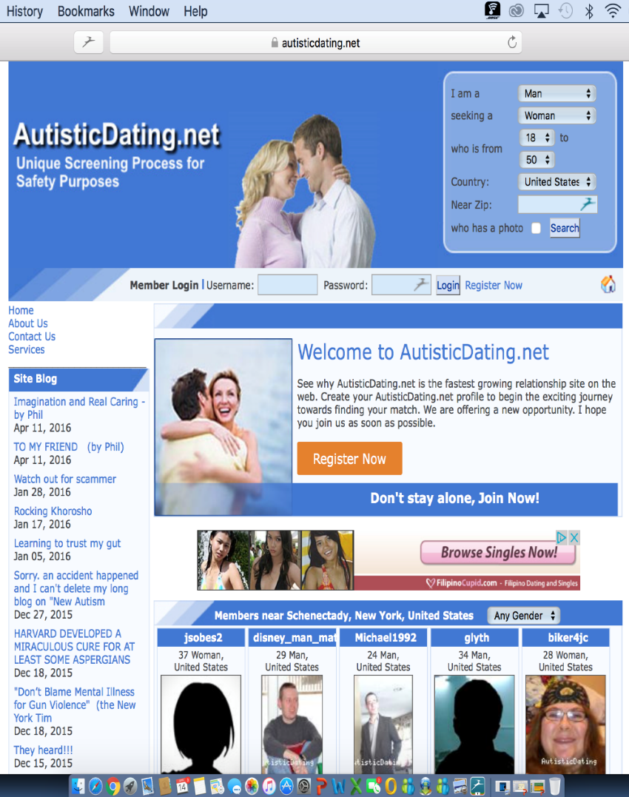
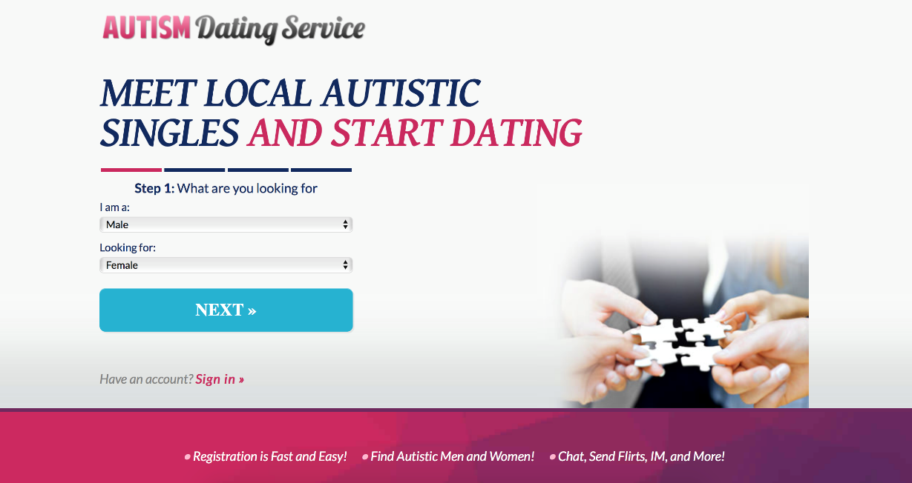
Autism Specific Internet Dating

Slide 39
Number 3 – Sexual Abuse
Brown-Lavoie, Viecili, & Weiss (2014) noted that individuals with ASD reported higher levels of sexual victimization that did typical controls.
Mandell et al (2005) reported that 18.5% of their sample (156 children) had been physically abused while 16.6% had been sexually abused.
Sevlever, Roth, & Gillis (2013) noted that more systematic research on the prevalence and risk factors of sexual abuse and offending is in great need if we are to adequately address this issue. The bottom line, this is an area where Behavior Analysis may have it’s greatest impact.
Brown-Lavoie, S.M., Vieceli, M.A., & Weiss, J.A., (2014). Sexual knowledge and victimization in adults with ASD. Journal of
Autism and Developmental Disorders, 44, 2185-2196
Sevlever, M., Roth, M.E. & Gillis, J.M. (2013). Sexual abuse and offending in ASD. Sexuality and Disability. 31, 189-200.
Mandell, D.S., et al (2005). The prevalence and correlates of abuse among children with autism served in comprehensive community-based mental health settings. Child Abuse and Neglect. 29, 1359-1372.
Notes:
Reason #3: Sexual Abuse: The statistics for sexual abuse within this country are staggering. Currently, it is believed that 1 out of every 4 children are sexually abused. For children with developmental disabilities it’s even worse.

Slide 40
Target skills to reduce abuse
Target discrimination between who can/cannot touch the individual and where on his or her body. This includes hugs, kisses, tickles, etc.
Target independent toileting, showering, menstrual care, and dressing.
Target closing and locking bathroom doors.
Target independent public restroom use.
Target functional noncompliance via the word “No”.
Target the recall of temporally distant events and report where instances of physical contact.
(American Academy of Pediatrics, 1996; Nehring, 2005; Roth & Morse, 1994; Volkmar & Wiesner, 2004)

Slide 41
Number 2
The Criminal Justice System

Slide 42
Individuals with intellectual and other developmental disabilities present unique characteristics that may contribute to the development of behavior considered offensive or criminal (Griffiths & Fedoroff, 2008).
Low levels of sexual knowledge coupled with high levels of interest/motivation and limited understanding of sexual rights and legalities (Pecora, Mesibov, & Stokes, 2016) are associated with higher rates of involvement in the criminal justice system than might otherwise expected (e.g., Loftin & Hartlage, 2015).
Griffiths, D. & Federoff, J.P., (2008). Persons with Intellectual Disabilities Who Sexually Offend. In F.M. Saleh, A.J. Grudzinskas, J.M. Bradford, & D.J. Brodsky (Eds) Sex Offenders: Identification, Risk Assessment, Treatment, and Legal Issues, p 352-374. New York: Oxford University Press.
Pecora, L.A., Mesibov, G.B., & Stokes, M.A., (2016). Sexuality in High-Functioning Autism: A Systematic Review and Meta-Analysis. Journal of Autism and Developmental Disorders

Slide 43
Number 1
Because They Are People & Like All People Individuals with Autism Have The Right To Learn All They Can To Enable Them To Become Sexually Healthy Persons

Slide 44
Working Definitions…
Sexuality is an integral part of the personality of everyone: man, woman, and child. It is a basic need and an aspect of being human that cannot be separated from other aspects of human life. Sexuality is not synonymous with sexual intercourse [and it] influences thoughts feelings, actions, and interactions and thereby our mental and physical health” (WHO, 1975)
Sex can simply mean gender, whether you’re male or female. Sex can also mean the physical act of sexual intercourse.
Sexuality education is a life-long process that encompasses many things: the biological, socio-cultural, psychological and spiritual dimensions of sexuality.

Slide 45
Further complicating things…
There are different types of sexual language including:
Formal/polite – Vagina
Technical – Labia, Cervix, Clitoris, Vulva
Cute – Va-jay-jay, Muffin, Little man in the boat, Punani, Lady parts, etc.
Slang – Snatch, Beaver, Twat, Pussy, etc.

Slide 46
In addition…
Individuals with autism can be concrete thinkers who interpret things literally, so…
Be frank during instruction
Provide clear visual and verbal examples
Avoid euphemisms
For example… (Rated R)

Slide 47
Some responses of adults with autism during an assessment* of sexual knowledge
Q: Tell me about this picture.
A: “[T]he people were sitting on the couch ‘being friends’.”
http://www.camboday.com/UnderstandingSex/healthsex/img/sex_sofa.jpg
(Konstantareas & Lunsky, 1997, p. 411)

Slide 48
Guidelines for teaching
Think ahead and be proactive
Be concrete
Serious, calm, supportive
Break larger areas of information into smaller, more manageable blocks
Be consistent, be repetitive
What are the practical implications
Teach all steps and in the correct order
Consider using multiple instructional mediums
Incorporate the social dimension of sexuality when and wherever appropriate
*Source: L. Mitchell, RCSW, The Cody Center

Slide 49
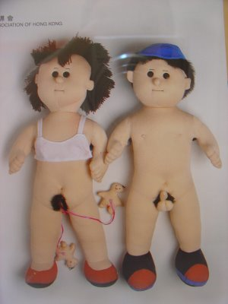
Teaching materials
Commercial products include:
Anatomically-correct dolls
Anatomical models of body parts
Written materials and pictures
Slide shows and videos
Shop carefully-- most products
were not created for people with ASD, and they are expensive

Slide 50
Teaching materials
Creating your own is easy and less costly
Resources include:
Medical and nursing textbooks
Patient education materials
Sexuality education books at the library
Google Image search
Planned Parenthood
Homemade digital photos & videos (NOT of nudity or private activities)

Slide 51
The 4 Basic Goals of Sex Ed
Provide accurate Information
Develop the necessary social competencies
Develop personal values
Promote individual safety

Slide 52
Information

Slide 53
Central Instructional Concepts
Public versus private behavior
Good touch versus bad touch
Proper names of body parts
“Improper” names of body parts
Personal boundaries/personal spaces
Masturbation
Avoidance of danger/Abuse prevention
Social skills and relationship building
Dating skills
Personal responsibility and values

Slide 54
What to teach and when… some general guidelines.*
Preschool through Elementary
Boys v. girls
Public v. private
Basic facts inc. body parts
Introduction to puberty (your changing body)
Introduction to menstrual care
Appropriate v. inappropriate touching
Bathing, dressing, and privacy
Source: Schwier, K.M., & Hingsburger, D. (2000)

Slide 55
Middle School & Beyond
Puberty & Menstruation (if not yet addressed)
Ejaculation and wet dreams (if not yet addressed)
How to say “no” (if not yet addressed)
Masturbation (if not yet addressed)
Public v private behavior
Public restroom use
Attraction and sexual feelings
Relationships and dating
Personal responsibility and family values
Sexual preference
Laws regarding sexuality
Pregnancy, safe sex, birth control
Etc.

Slide 56
The same techniques we use to teach other behaviors can be used in this area too
Activity Schedules
Shaping
Chaining
Prompting
Video-Modeling
Discrete Trial Instruction
Massed Practice
Functional Assessment

Slide 57
Public/Private Discriminations at Home
From an early age families need to be clear and consistent with family rules about privacy
Restrict nudity in public parts of the house
Dress and undress in bedroom or bathroom
Close doors and window shades for private activities
Teach use of robe
Caregivers should model knocking on closed doors before going in
(American Academy of Pediatrics, 1996; NICHCY, 1992; SIECUS, 2001)

Slide 58
Preventing Problems with Masturbation
Early on designate where it is OK to masturbate
Individual’s bedroom
Avoid teaching use of bathroom
Teach rules for appropriate time/ place
Teach sometimes it’s not an option
Schedule private time
(Baxley & Zendell, 2005; Koller, 2000; NICHCY, 1992; Volkmar & Wiesner, 2004)

Slide 59
Intervention with Situationally Problematic Masturbation
Interrupt the behavior as soon as possible but don’t punish or overreact
Remind the individual of the rules for appropriate masturbation (referring to any visual supports necessary)
Redirect the student to:
An activity that requires use of hands
A physical activity
An activity that requires intense focus
To his/her bedroom, if available
Reinforce student when he/she is engaging in appropriate behavior
(Baxley & Zendell, 2005; Koller, 2000; NICHCY, 1992; Volkmar & Wiesner, 2004)

Slide 60
VALUES (I am not going to talk about values)

Slide 61
SOCIAL COMPETENCE

Slide 62
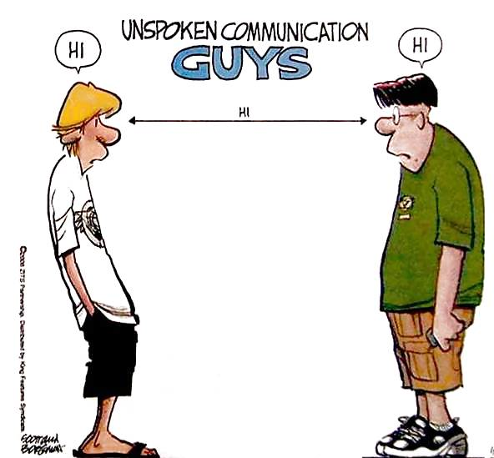
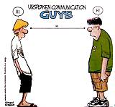
\\

Slide 63
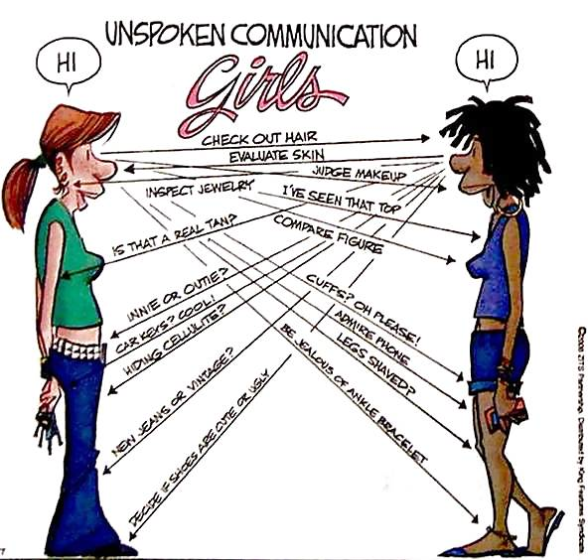

Slide 64
Challenges to Sexuality Education for Learners with ASD.
The social dimension of sexual behavior
Differentiation between public and private behavior and reality v. fantasy
Ensuring the maintenance of learned skills, particularly those associated with sexual safety
Balancing individual safety with personal respect and individual rights
Issues related to law enforcement

Slide 65
Some Resources

Slide 66
Some Resources

Slide 67
Some Resources

Slide 68
AND LASTLY

Slide 69
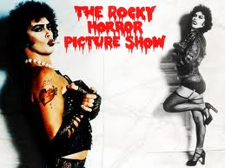
Don’t dream it. Be it!

Slide 70
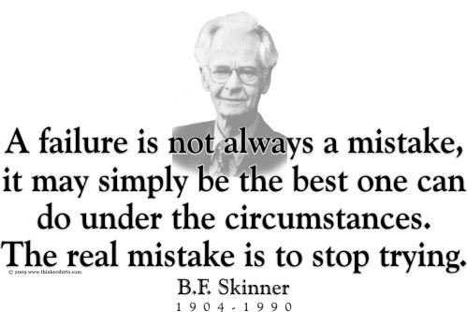

Slide 71
