Slide 1
Big10 Compensation Comparison
Prepared by the Academic Affairs committee and the Executive Vice President

Slide 2
Purpose
Compare the minimum compensation offered at UNL with other universities in the Big10.
About half of graduate students at UNL have an assistantship.

Slide 3
Disclaimer
We used publicly available information from official university websites to compile this report. If you find any errors, please let academicaffairsgsa@unl.edu or vicepresidentgsa@unl.edu know.

Slide 4
Things to keep in mind
Graduate Studies says most people make more than the minimum
No data provided to support or reject this claim
The minimum only has to do with tuition remission
Students theoretically can make less than the minimum
Departments may have their own minimum higher than the university minimum
Guidelines used to determine stipend levels should be available to student through the department

Slide 5
Methodology
 | UNL | Illinois, Urbana | IU, Bloomington | U of Iowa | U of Maryland | U of Michigan | Michigan State | Minnesota | Northwestern | The Ohio State | Penn State | Purdue | Rutgers | U of Wisconsin
1 semester |  | $ 5,000 |  |  | $ 9,375 | $ 11,598
2 semesters (10mo) | $ 10,610 | $ 10,000 | $ 15,000 | $ 20,302 | $ 17,500 | $ 23,196 | $ 15,560 | $ 17,303 | $ 29,330 | $ 21,280 | $ 20,790 | $ 13,793 | $ 30,162 | $ 20,500
1 yr |  | $ 13,333 |  | $ 24,804 | $ 25,000 |  |  | $ 20,764 | $ 35,196 | $ 28,373 |  | $ 16,551 | $ 33,999
at 0.49fte
tuition remission (assume resident) | $ 6,138 | $ 13,179 | $ 7,432 | $ 10,432 | $ 13,824 | $ 12,451 | $ 14,710 | $ 17,844 | $ 56,067 | $ 6,503 | $ 18,700 | $ 9,208 | $ 6,813 | $ 12,174
fees paid by student | $ 806 | $ 560 | $ 1,420 | $ 275 | $ 818 | $ 164 | $ 144 | $ 1,152 | $ 375 | $ - | $ - | $ 784 | $ - | $ 1,452
fees covered by school | $ - | $ 1,950 | $ - | $ 440 | $ - | $ - | $ - | $ - | $ - | $ 465 | $ 530 | $ - | $ 608 | $ -
insurance paid by student | $ 698 | $ 119 | $ - | $ 488 | $ 134 | $ - | $ - | $ 306 | $ 4,386 | $ 631 | $ - | $ 620 | $ - | $ 3,406
insurance covered by school | $ 2,625 | $ 797 | $ 3,404 | $ 4,396 | $ - | $ 3,720 | $ 2,850 | $ 968 | $ - | $ 3,577 | $ 2,930 | $ 2,101 | $ 2,347 | $ -
(insurances and fees for 12 mo)
Total Compensation | $ 17,869 | $ 25,247 | $ 24,415 | $ 34,806 | $ 30,372 | $ 39,203 | $ 32,976 | $ 34,657 | $ 80,636 | $ 31,193 | $ 42,950 | $ 23,698 | $ 39,930 | $ 27,816
Spending Cash Before Tax | $ 9,106 | $ 9,321 | $ 13,580 | $ 19,538 | $ 16,548 | $ 23,032 | $ 15,416 | $ 15,845 | $ 24,569 | $ 20,649 | $ 20,790 | $ 12,389 | $ 30,162 | $ 15,642
MIT living wage | $ 30,617 | $ 31,163 | $ 28,633 | $ 28,187 | $ 41,222 | $ 32,489 | $ 28,038 | $ 32,545 | $ 33,953 | $ 28,921 | $ 29,387 | $ 27,964 | $ 37,147 | $ 32,255
Normalized Total Compensation | $ 17,869 | $ 24,804 | $ 26,107 | $ 37,807 | $ 22,558 | $ 36,944 | $ 36,009 | $ 32,604 | $ 72,713 | $ 33,022 | $ 44,748 | $ 25,946 | $ 32,911 | $ 26,404
Normalized Cash Before Tax | $ 9,106 | $ 9,158 | $ 14,520 | $ 21,223 | $ 12,291 | $ 21,705 | $ 16,834 | $ 14,907 | $ 22,155 | $ 21,860 | $ 21,660 | $ 13,564 | $ 24,860 | $ 14,848
Assumptions
A two-semester appointment with no summer pay at 0.5 or 0.49 FTE
A full year of health insurance
Resident tuition for tuition remission
Normalized for Lancaster County cost of living
*If you find any errors, please let academicaffairsgsa@unl.edu or vicepresidentgsa@unl.edu know.

Slide 6
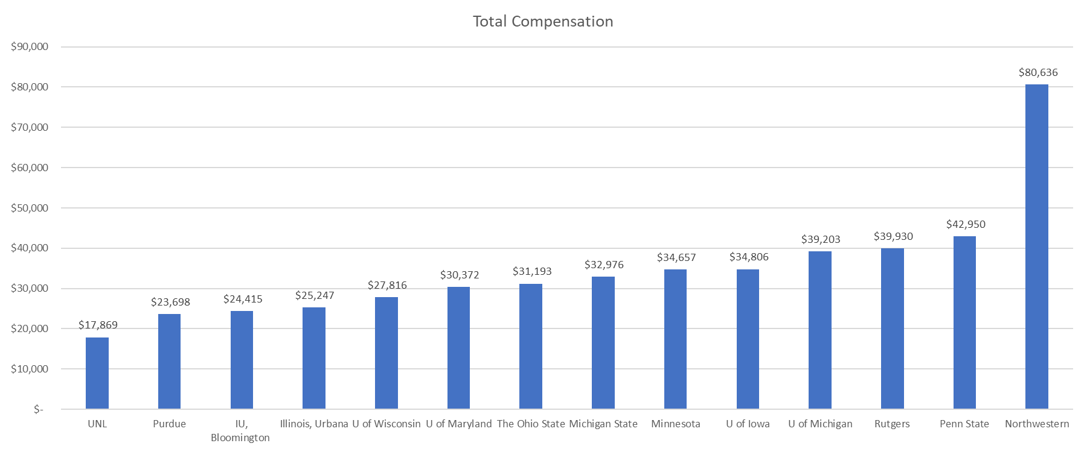
Results
Average excluding UNL: $35,992
If you find any errors, please let academicaffairsgsa@unl.edu or vicepresidentgsa@unl.edu know.

Slide 7
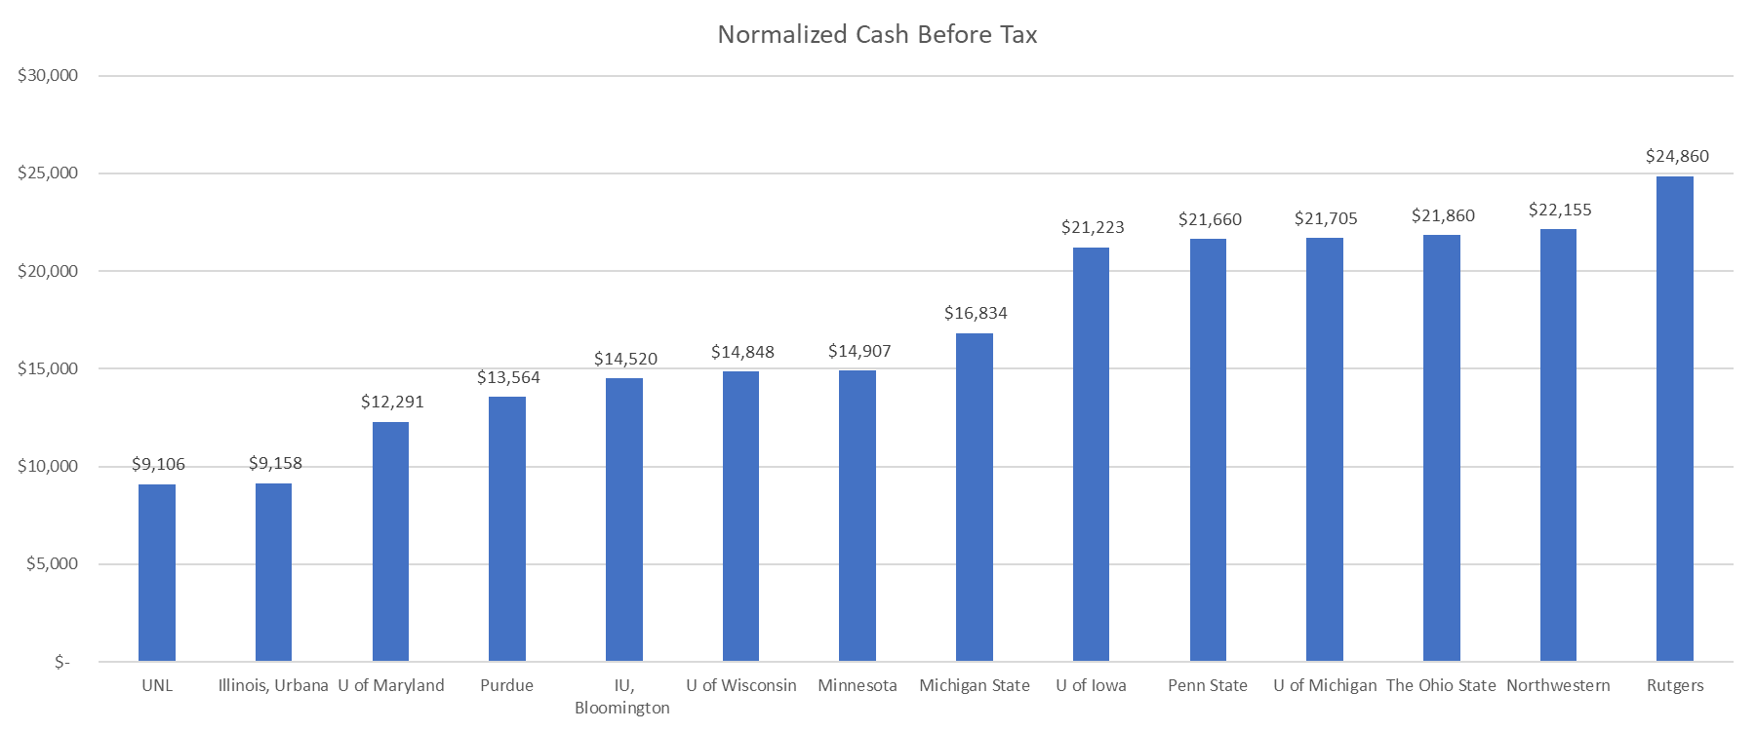
Results
Average excluding UNL: $17,660
If you find any errors, please let academicaffairsgsa@unl.edu or vicepresidentgsa@unl.edu know.

Slide 8
Conclusions
Formula
(Take home + Fees + Insurance = Minimum Stipend)
UNL’s Current Minimum
$9,106 + $806 + $698 = $10,610
Big10 Average Minimum
$17,660 + $806 + $698 = $19,164
UNL Estimated Cost of Attendance
Housing/Meals $13,162 + Books/Supplies $870 + Personal Expenses $3,634 = $17,666

Slide 9
Next Steps
Meet again with Graduate Studies
Find out who actually sets the minimum stipend level at UNL
Meet with them
Determine minimums in departments (GSA Bill #5)
(Hold questions and discussions on the bill until it is on the floor)

Slide 10
Questions

